Slide 1
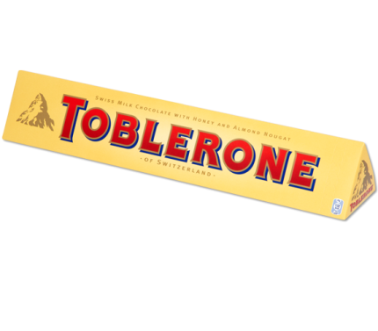
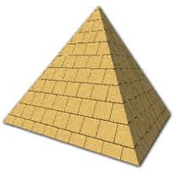
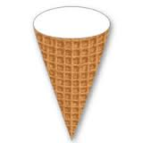
3D Shape
+
Addition

Slide 2
LS – To identify properties of 3D Shape.
To solve addition calculations involving the properties of 3D shape.

Slide 3
Key Vocabulary I need to know –
Faces
Vertices
Edges

Slide 4
How many vertices?

Slide 5
How many vertices?

Slide 6
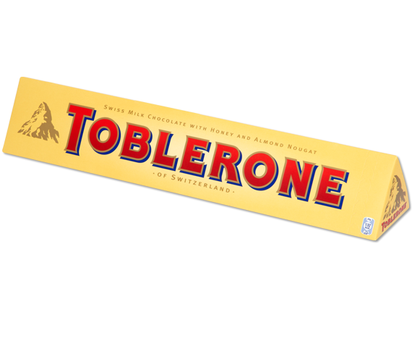
How many vertices?

Slide 7
How many faces?

Slide 8
How many faces?

Slide 9
How many faces?

Slide 10
How many edges?

Slide 11
How many edges?

Slide 12
How many edges?

Slide 13
How many vertices?

Slide 14
How many vertices?

Slide 15
How many vertices?

Slide 16
How many faces?

Slide 17
How many faces?

Slide 18
How many faces?

Slide 19
How many edges?

Slide 20
How many edges?

Slide 21
How many edges?

Slide 22
How many vertices?

Slide 23
How many faces?

Slide 24
How many edges?

Slide 25
How many vertices?

Slide 26
How many faces?

Slide 27
How many edges?

Slide 28
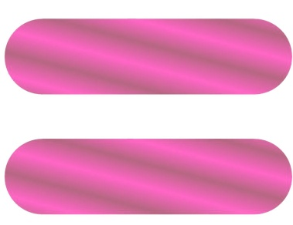
Vertices, edges or faces?
16

Slide 29
Vertices, edges or faces?
6

Slide 30
Vertices, edges or faces?
24

Slide 31
Vertices, edges or faces?
4

Slide 32
Vertices, edges or faces?
12

Slide 33
Vertices, edges or faces?
10

