Slide 1
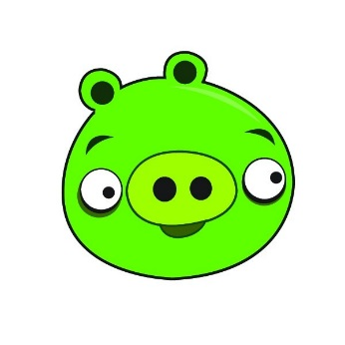
8/04/2014 WALT: Identify characteristics of good and bad characters.
Aspire: I can use a thesaurus to up-level vocabulary choices.
Challenge: I can talk about good and bad characteristics and relate vocabulary to these.
Achieve: I can sort characteristics to match good and bad characters.

Slide 5
