Slide 1
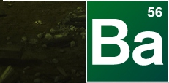

Slide 2
Baking Bad – Season 2
The story of a desperate Food Technology teacher…

Slide 3
The Back Story
William “Billy” Black has been a Food Technology teacher for years, won awards at local bake-offs and is well known for producing the best cakes in the local area. As a result he has been earmarked by visiting aliens to become their planet’s official chef. Billy has therefore decided to sell his wares to provide for his family when he’s gone…

Slide 4
Your help is required…
Can you help William “Billy” Black calculate the following:
The volume of his cake tins to he knows how much cake mixture is required for each?
The surface area of his cake tins so that he knows how much non-stick baking paper is required to prevent his cakes sticking?

Slide 5
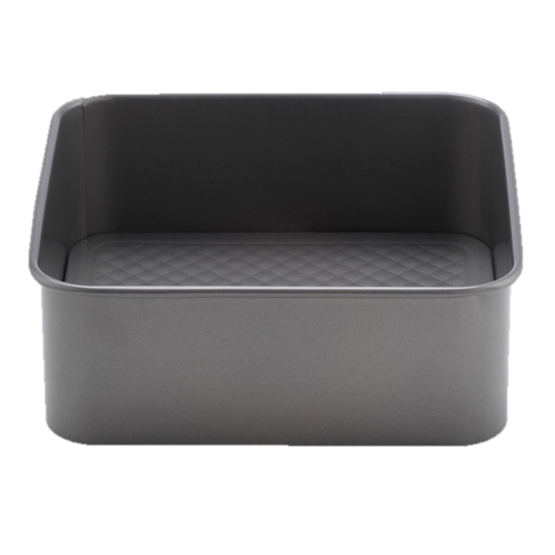
Cake Tin 1
This cake tin is a square-based cuboid.
The length of each side of the tin is 25cm.
The height of the tin is 8cm.
Volume:
$$25×25×8$$
$$=5000{cm}^{3}$$
Surface Area:
$$25×25+4×25×8$$
$$=1425{cm}^{2}$$

Slide 6
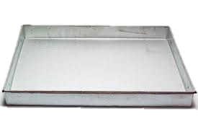
Cake Tin 2
Volume:
3$5×20×4$
$$=2800{cm}^{3}$$
Surface Area:
$$35×20+2×35×4+2×20×4$$
$$=1140{cm}^{2}$$
This cake tin is a rectangular-based cuboid.
The length of the tin is 35cm.
The width of the tin is 20cm.
The height of the tin is 4cm.

Slide 7
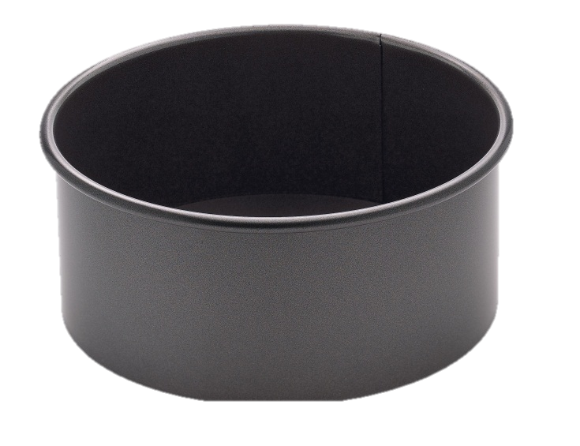
Cake Tin 3
This cake tin is a cylinder.
The diameter of the tin is 20cm.
The height of the tin is 12cm.
Volume:
$$π×{10}^{2}×12$$
$$=1200π or 3769.9{cm}^{3}$$
Surface Area:
$$π×{10}^{2}+12×π×20$$
$$=340π or 1068.1{cm}^{2}$$

Slide 8
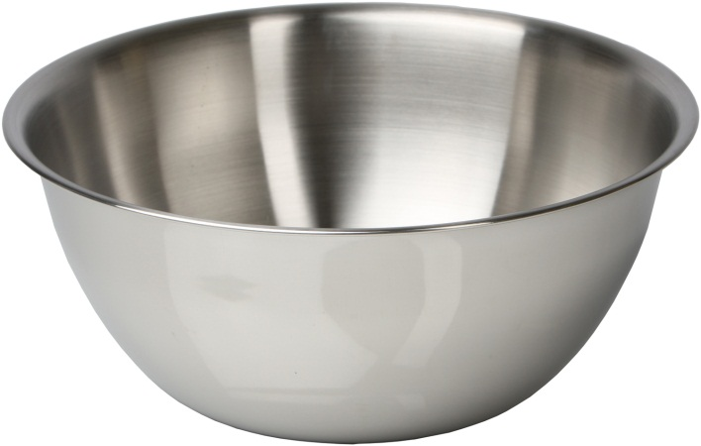
Cake Tin 4
Volume of a sphere:
$$\frac{4}{3}{πr}^{3}$$
Surface area of a sphere:
$$4{πr}^{2}$$
This cake tin is a hemisphere.
The diameter of the tin is 24cm.
Volume:
$$\frac{4}{3}×π×{12}^{3}÷2$$
$$=1152π or 3619.1{cm}^{3}$$
Surface Area:
$$4×π×{12}^{2}÷2$$
$$=288π or 904.8{cm}^{2}$$

Slide 9
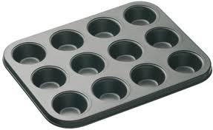
Cake Tin 5
Volume of a cone:
$$\frac{1}{3}{πr}^{2}h$$
Curved surface area of a cone:
$$πrl$$
Each section of this cake tin is a circular-based frustum.
The radius at the top of each section is 6cm.
The radius at the bottom of each section is 3cm.
The depth of each section is 4cm.
Volume:
$$84π or 263.9{cm}^{3}$$
Surface Area:
$$93π or {292.2cm}^{2}$$

Slide 10
Thanks for all your help!

