Slide 1
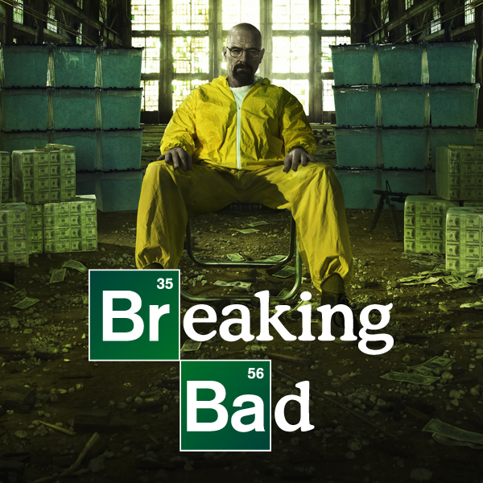
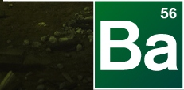

Slide 2
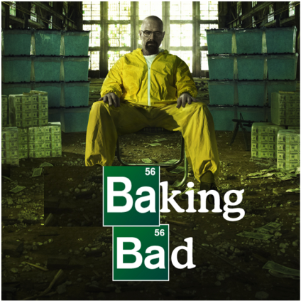
Baking Bad – Season 4
The story of a desperate Food Technology teacher…

Slide 3
The Back Story
William “Billy” Black has been a Food Technology teacher for years, won awards at local bake-offs and is well known for producing the best cakes in the local area. As a result he has been earmarked by visiting aliens to become their planet’s official chef. Billy has therefore decided to sell his wares to provide for his family when he’s gone…

Slide 4
A competition!
William “Billy” Black is now catering at events. Presentation is everything so he likes to arrange his triangular cakes on the tables in certain ways, offering a prize of a free cake for those who describe the transformation of Cake A to Cake B fully first.

Slide 5
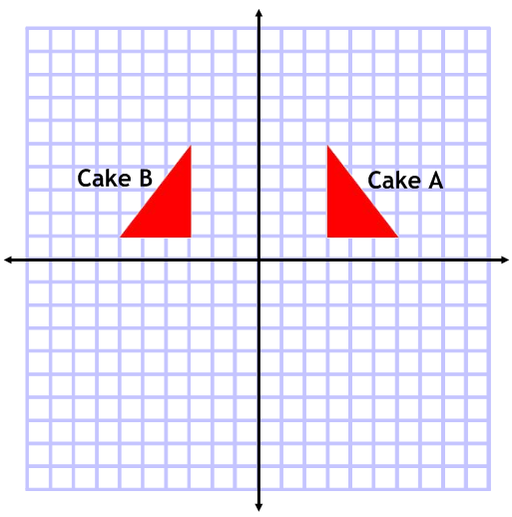
Design 1
Answer:
Reflection in the y-axis or line x=0

Slide 6
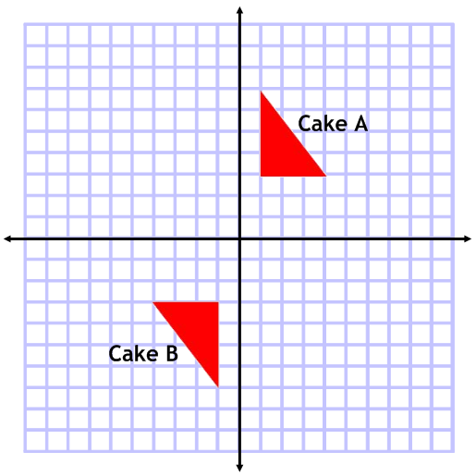
Design 2
Answer:
Rotation, 180⁰, centre (0,0) or the origin

Slide 7
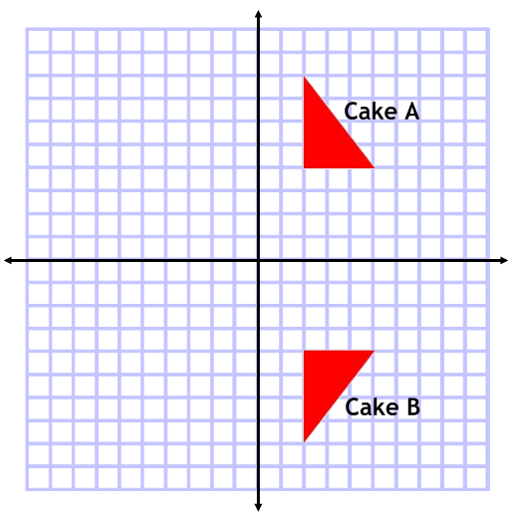
Design 3
Answer:
Reflection in the x-axis or line y=0

Slide 8
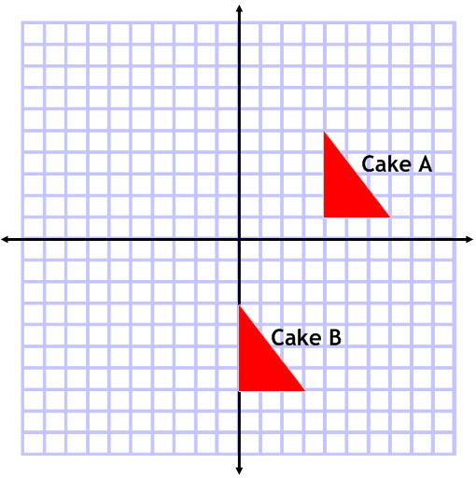
Design 4
Answer:
Translation $\left({−4 \atop −8}\right)$

Slide 9
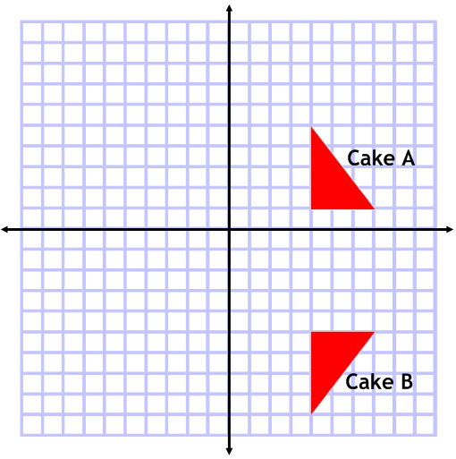
Design 5
Answer:
Reflection in the line y=-2.

Slide 10
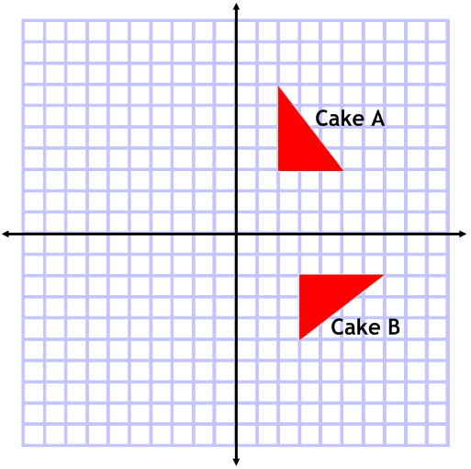
Design 6
Answer:
Rotation, 90⁰ clockwise, centre (0,0) or the origin

Slide 11
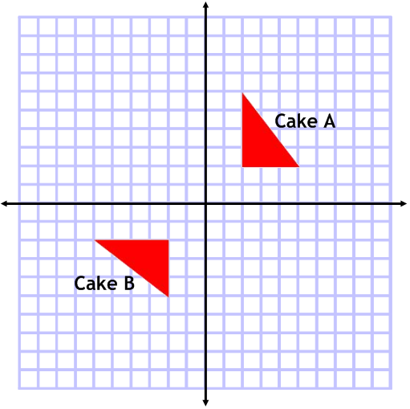
Design 7
Answer:
Reflection in the line y=x.

Slide 12
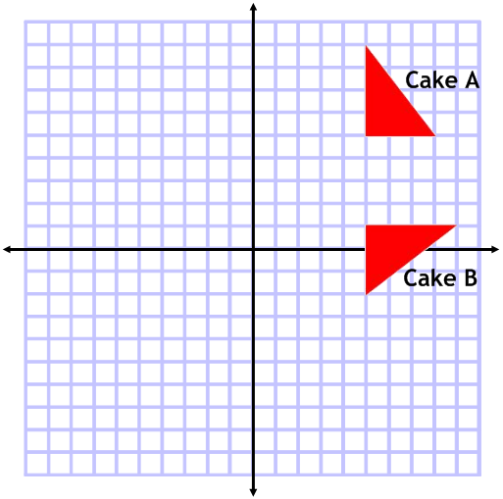
Design 8
Answer:
Rotation, 90⁰ clockwise, centre (3,3)

Slide 13
How many cakes would you have won?

