Slide 1
Barbie and Ken's Mathematical Adventures

Slide 2
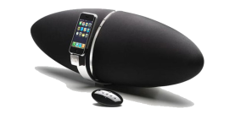
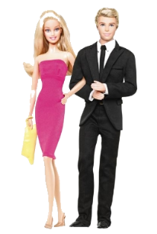
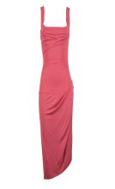
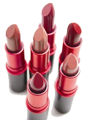
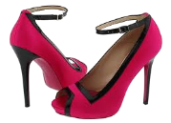
Department Store
They start and finish at the escalator, but go in the following order:
Make-up and Perfume
Shoes
Women’s Clothing
Electronic Goods
Sporting Goods
Electronic Goods
Sporting Goods
Women's Clothing
Escalator
Make-up and Perfume
Shoes

Slide 3
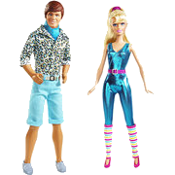
What items lie on the following lines in their penthouse (some may have more than one item on):
1. x = 5?
2. y = 3?
3. x = -4?
4. y = -2?
5. y = x?
6. y = - x?
Bed
Sink
Toilet
Cabinet
Cabinet
5
Bath
-5
5
Chair
Fridge
-5
Table
Sofa
TV
Sink
Cooker

Slide 4
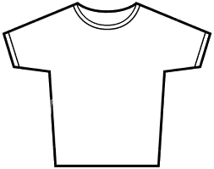
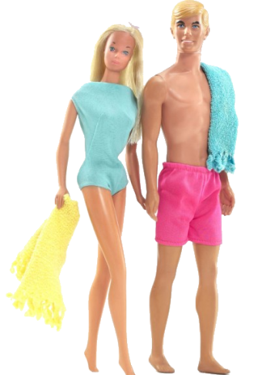
Describe the transformation of each shape on Ken's T-shirt:

