Slide 1
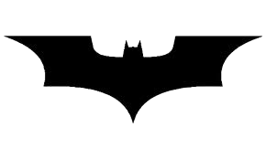
Batman's Bearings
Give the direction and bearing upon which Batman has to travel and use the scale to calculate how far he has gone whilst catching all the criminals.
Note: all directions are North, North East, East, South East, South, South West, West or North West.

Slide 2
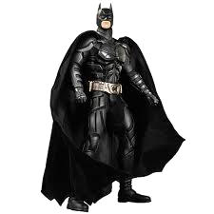
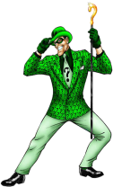
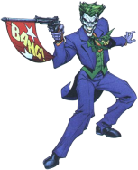
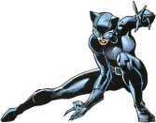
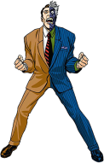
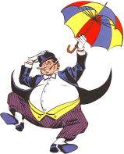
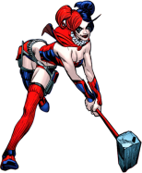
Start
Scale
1cm:500m
N
Batman's Journey
Batman
N
Riddler
N
The Joker
Catwoman
N
N
N
Two Face
Harley Quinn
Penguin
N

