Slide 1
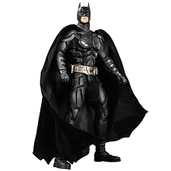
Batman Trigonometry
The Police Commissioner needs your help to calculate the missing measurements in the following situations.

Slide 2
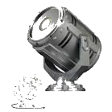
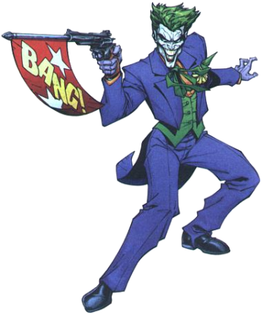
9km
23º
How far to the scene?
The Joker

Slide 3
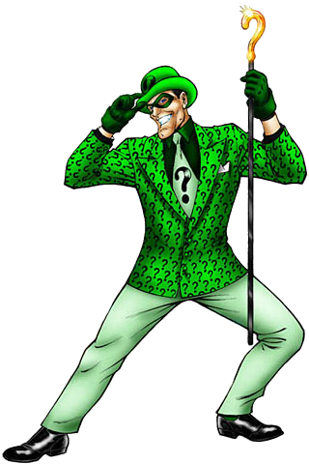
7km
14º
How far to the scene?
The Riddler

Slide 4
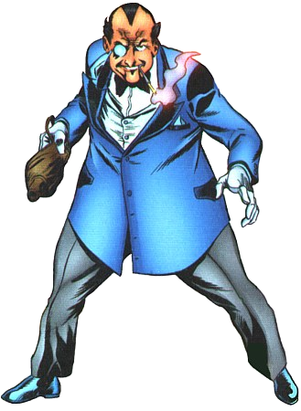
19km
What angle must the light be at?
14km
Penguin

Slide 5
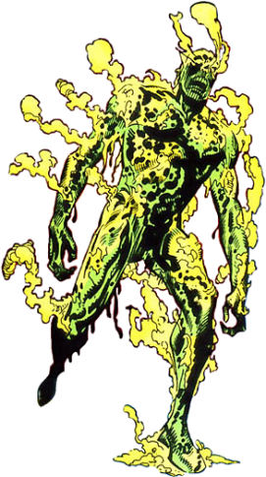
5km
What angle must the light be at?
14km
Corrosive Man

