Slide 1
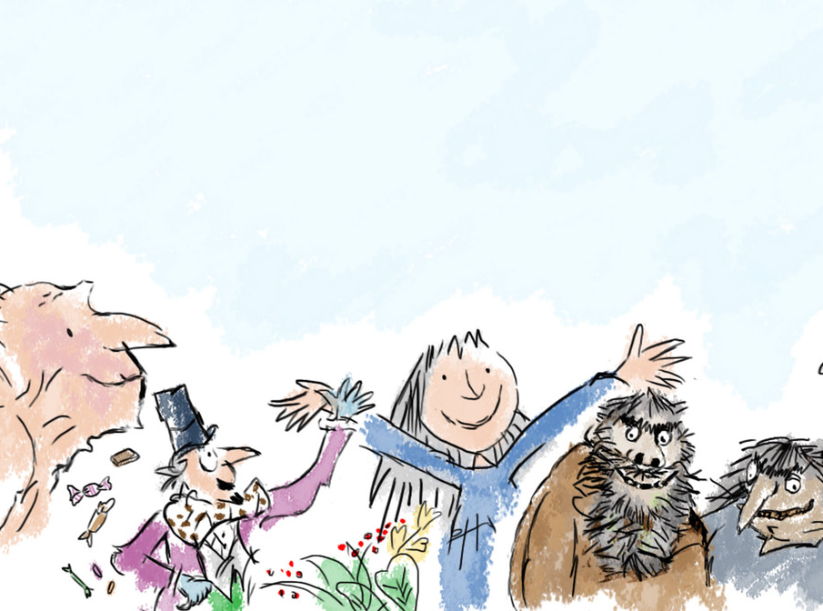
Dahl’s Dinner Party
Mathematics

Slide 2
In order to celebrate Roald Dahl’s hundredth birthday the characters have been invited to a celebratory dinner party.
The guests include: The BFG, Willy Wonka, Matilda, The Twits and many more. Unfortunately, the seating plan has not be completely finished yet and it is important that people are sat in the correct places.
You must use the clues provided to work out which guest sits where at the party.

Slide 3
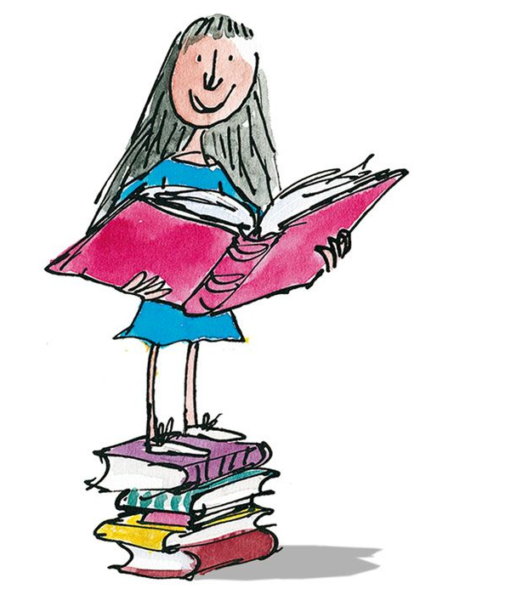
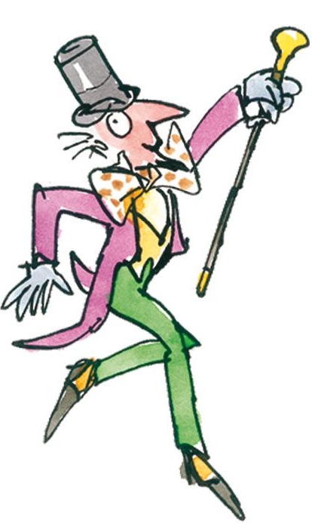
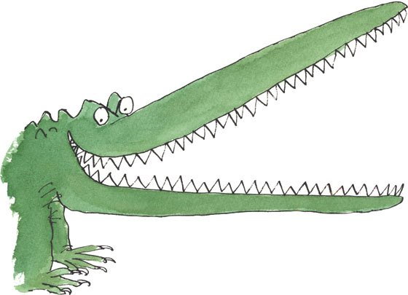
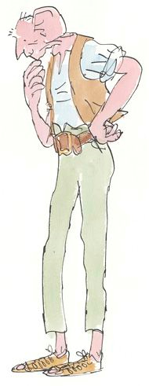
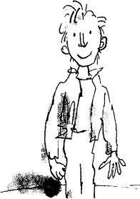
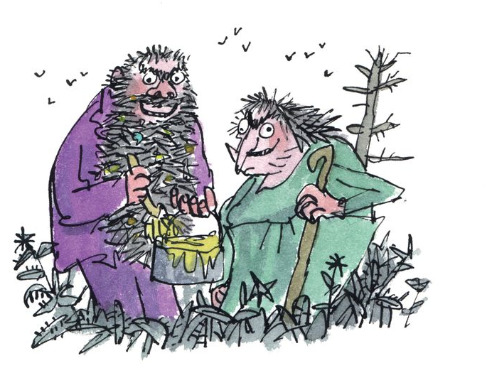

Slide 4
Clue 1: Willy Wonka is not sitting opposite James.
Clue 2: Mrs. Twit is sitting next to Matilda and Willy Wonka.
Clue 3: James sits opposite Mrs. Twit.
Where does everyone sit?

Slide 5
Clue 1: Willy Wonka sits opposite Sophie.
Clue 2: Matilda sits between James and Sophie.
Clue 3: Mrs. Twit sits beside Willy Wonka.
Clue 4: James sits opposite Sophie.
Where does everyone sit?

Slide 6
Clue 1: Charlie does not sit at the end of the table.
Clue 2: James sits between Willy Wonka and Sophie.
Clue 3: Sophie sits next to Danny but NOT next to Willy Wonka.
Clue 4: Matilda sits opposite Willy Wonka.
Clue 5: Charlie sits between two females.
Where does everyone sit?

