Slide 1
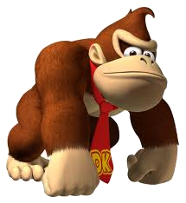
Dinky King 7 - Murrio's In The Area
Exclusive to the Nantindoo Woo Hoo Games Console
Featuring:
Dinky King
Murrio

Slide 2
The aim of the game:
Murrio must collect the stars. The number of stars on each level is equal to the level's area in square metres to the nearest whole number.
Each star is worth 30 points.
Dinky King will attempt to stop Murrio but cannot collect stars himself.
Levels are complete when Murrio has collected every star.

Slide 3
Your task:
What is the maximum number of points from collecting stars that Murrio can win on each level?
(You are given floor plans of each level.)
Each star = 30 points

Slide 4
Level 1
25m
12m

Slide 5
Level 2
20m
24m

Slide 6
Level 3
18m
20m
20m

Slide 7
Level 4
16m
15m
26m

Slide 8
Level 5
25m
8m
15m
15m

Slide 9
Level 6
40m
15m
15m

Slide 10
Level 7
30m

Slide 11
Level 8
48m

Slide 12
Level 9
23m
23m

Slide 13
Level 10
15m
8m
15m
32m

Slide 14
Levels Complete!

