Slide 1
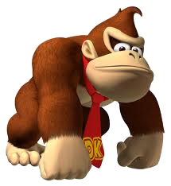
Dinky King 8 - Murrio Turn Up The Volume
Exclusive to the Nantindoo Woo Hoo Games Console
Featuring:
Dinky King
Murrio

Slide 2
The aim of the game:
In the latest version of the game, Murrio has gone 3D. Murrio must collect the stars. The number of stars on each level is equal to the level's volume in cubic metres to the nearest whole number.
Each star is worth 30 points.
Dinky King will attempt to stop Murrio but cannot collect stars himself.
Levels are complete when Murrio has collected every star.

Slide 3
Your task:
What is the maximum number of points from collecting stars that Murrio can win on each level?
(You are given the dimensions of each level.)
Each star = 30 points

Slide 4
Level 1
25m
10m
15m

Slide 5
Level 2
28m
28m
28m

Slide 6
Level 3
12m
30m
18m

Slide 7
Level 4
Area: 150m²
24m

Slide 8
Level 5
35m
16m

Slide 9
Level 6
15m
25m
25m

Slide 10
Level 7
28m
16m

Slide 11
Level 8
36m

Slide 12
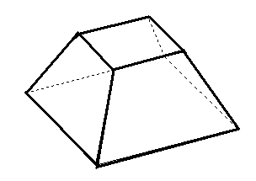
Level 9
16m
16m
10m
32m
32m

Slide 13
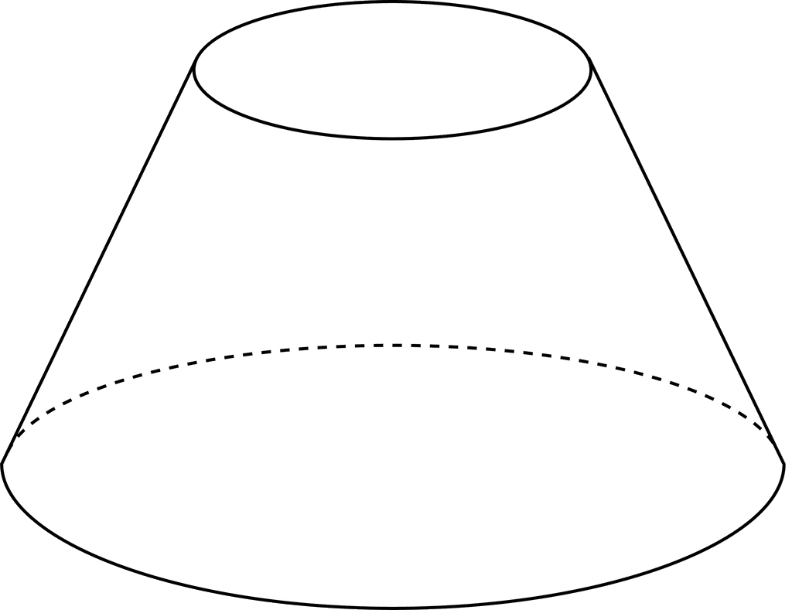
Level 10
16m
10m
24m

Slide 14
Levels Complete!

