Slide 1
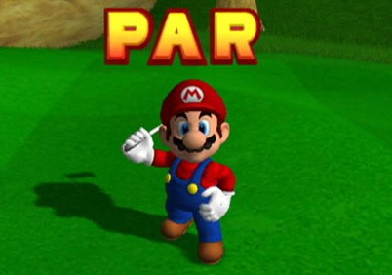
MURRIO

Slide 2
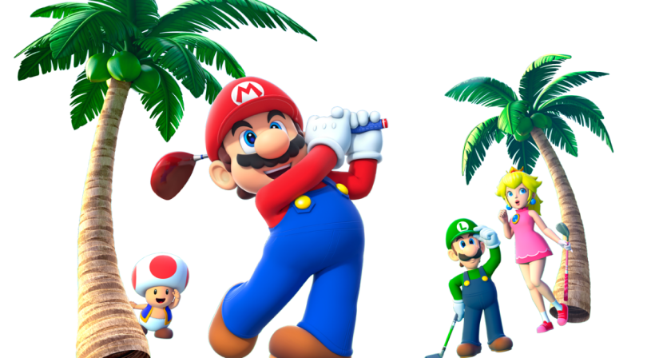
Our game manufacturers are designing a 9 hole golf course based on the mathematical principles of transformations, but we need your help putting in the bunkers and water hazards, which will be mathematical shapes.
Each hole has instructions from the designers about what they want the hole to look like, so can you please follow them just to reassure the designers that they have got it right?

Slide 3
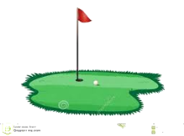
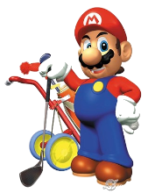
Hole 1
Instructions for Hole 1:
Reflect the bunker in the x-axis.
Rotate the water hazard 180º, centre (0,0).
Water hazard
Bunker

Slide 4
Hole 2
Instructions for Hole 2:
Rotate the bunker 90º anti-clockwise, centre (0,0).
Reflect the water hazard in the y-axis.
Water hazard
Bunker

Slide 5
Hole 3
Instructions for Hole 3:
Reflect the bunker in the y-axis.
Translate the water hazard in the vector
( ).
-2
-4
Water hazard
Bunker

Slide 6
Hole 4
Water hazard
Instructions for Hole 4:
Reflect the bunker in the y=2 line.
Reflect the water hazard in the x=-1 line.
Bunker

Slide 7
Hole 5
Instructions for Hole 5:
Rotate the bunker 90⁰ anti-clockwise, centre (1,4).
Reflect the water hazard in the x=-3 line.
Bunker
Water hazard

Slide 8
Hole 6
Instructions for Hole 6:
Reflect the bunker in the y=-2 line.
Translate the water hazard in the vector
( )
Bunker
1
6
Water hazard

Slide 9
Hole 7
Instructions for Hole 7:
Rotate the bunker 180º, centre (-1,-2).
Reflect the water hazard in the x=-1 line.
Water hazard
Bunker

Slide 10
Hole 8
Instructions for Hole 8:
Translate the bunker in the vector
( ).
Reflect the water hazard in the y=x line.
Bunker
2
-3
Water hazard

Slide 11
Hole 9
Instructions for Hole 9:
Rotate the bunker 90º anti-clockwise, centre (4,2).
Reflect the water hazard in the y=1 line.
Bunker
Water hazard

Slide 12
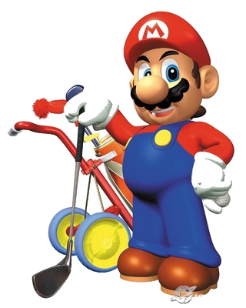
Thanks for all your help!
Here are the answers...

Slide 13
Hole 1
Instructions for Hole 1:
Reflect the bunker in the x-axis.
Rotate the water hazard 180º, centre (0,0).
Water hazard
Bunker

Slide 14
Hole 2
Instructions for Hole 2:
Rotate the bunker 90º anti-clockwise, centre (0,0).
Reflect the water hazard in the y-axis.
Water hazard
Bunker

Slide 15
Hole 3
Instructions for Hole 3:
Reflect the bunker in the y-axis.
Translate the water hazard in the vector
( ).
-2
-4
Water hazard
Bunker

Slide 16
Hole 4
Water hazard
Instructions for Hole 4:
Reflect the bunker in the y=2 line.
Reflect the water hazard in the x=-1 line.
Bunker

Slide 17
Hole 5
Instructions for Hole 5:
Rotate the bunker 90⁰ anti-clockwise, centre (1,4).
Reflect the water hazard in the x=-3 line.
Bunker
Water hazard

Slide 18
Hole 6
Instructions for Hole 6:
Reflect the bunker in the y=-2 line.
Translate the water hazard in the vector
( )
Bunker
1
6
Water hazard

Slide 19
Hole 7
Instructions for Hole 7:
Rotate the bunker 180º, centre (-1,-2).
Reflect the water hazard in the x=-1 line.
Water hazard
Bunker

Slide 20
Hole 8
Instructions for Hole 8:
Translate the bunker in the vector
( ).
Reflect the water hazard in the y=x line.
Bunker
2
-3
Water hazard

Slide 21
Hole 9
Instructions for Hole 9:
Rotate the bunker 90º anti-clockwise, centre (4,2).
Reflect the water hazard in the y=1 line.
Bunker
Water hazard

Slide 22
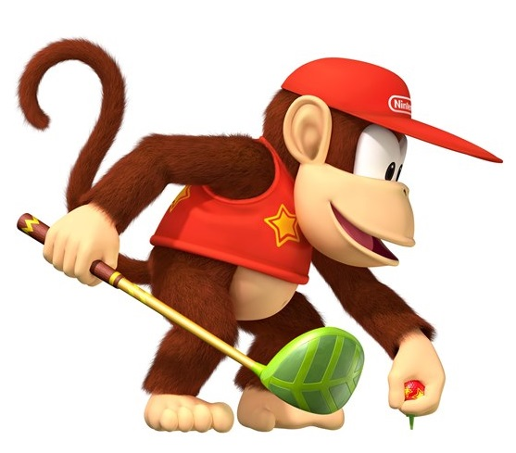
Play Ball!

