Slide 1
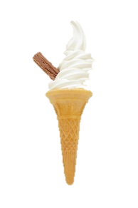
Season 3
“a cold snack is Coming…”
Radio Times: “Ice cream has got serious”

Slide 2
Back Story:
The city of Easteros, situated on the coast of Wessos, is the scene of a bitter ice cream feud between two companies:
Lark Ices (run by Edward Lark)
Stannister Dairy (run by Bob Stannister)
Both men, through their companies, are trying to win control of the frozen dairy market in Easteros, and will stop at nothing to achieve their goal!
The saga has become known as the “Games Of Cones”.

Slide 3
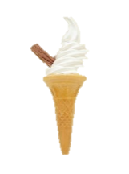
Freezer Bird
The two businesses are very strict with regards to timings:
Lark Ices work with 12 hour time.
Stannister Dairy work with 24 hour time.
The timings have got mixed up.
Can you convert each company’s times?

Slide 4
Freezer Bird
Lark Ices Timesheet
Stannister Dairy Timesheet
Beach | Arrive | Depart
Walled | 0830 | 1545
Valerie | 0915 | 1600
Iron | 1010 | 1640
Daroky | 1135 | 1925
Beach | Arrive | Depart
Walled | 8.10am | 2.30pm
Valerie | 7.45am | 1.50pm
Iron | 9.25am | 5.15pm
Daroky | 10.05am | 8.20pm
8.30am
3.45pm
0810
1430
9.15am
4.00pm
0745
1350
10.10am
4.40pm
0925
1715
11.35am
7.25pm
1005
2020
Copy the tables and convert the times to the 12 hour clock for Lark Ices and 24 hour clock for Stannister Dairy.

Slide 5
I Came, Ice Or I Conquered
A couple of electrical storms in Easteros have played havoc with the clocks in one van from each company.
Lark Ices use analogue clocks.
Stannister Dairy use digital clocks.
Can you find out what the real time is in each case from the clues given?

Slide 6
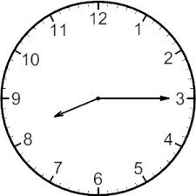
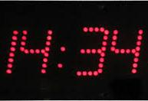
I Came, Ice Or I Conquered
Lark Ices
Stannister Dairy
The Lark Ices clock is 2 hours and 25 minutes slow.
The Stannister Dairy clock is 1 hour and 42 minutes fast.
10.40am
1252

Slide 7
Frozen In Time
In order to calculate the wages of the sellers in each van the companies need to calculate how long the vans are at each venue.
Can you calculate how long each van for each company was at each beach?

Slide 8
Frozen In Time
Lark Ices Timesheet
Stannister Dairy Timesheet
Beach | Arrive | Depart | Total
Walled | 8.30am | 3.45pm
Valerie | 9.15am | 4pm
Iron | 10.10am | 4.40pm
Daroky | 11.35am | 7.25pm
Beach | Arrive | Depart | Total
Walled | 0810 | 1430
Valerie | 0745 | 1350
Iron | 0925 | 1715
Daroky | 1005 | 2020
7h 15m
6h 20m
6h 45m
6h 5m
6h 30m
7h 50m
7h 50m
10h 15m
Fill in the time each van remained at each beach.
Which company has it’s vans out the most in total and by how much?
Lark Ices: 28h 20m
Stannister Dairy: 30h 30m (more by 2h 10m)

Slide 9
Ice Road Tekkers
Both companies try to reach as many potential customers as possible so have one van each that goes around the area stopping off at given points to sell their products.
The Easteros tourism board wants to clarify certain things for the FAQ section of their website.
Can you answer the questions for them?

Slide 10
Ice Road Tekkers
Lark Ices
Stannister Dairy
Location | Round 1 | Round 2 | Round 3
Play Ground | 8.35am | 2.35pm | 5.35pm
High Street | 8.50am | 3.50pm | 5.50pm
Skate Park | 9.27am | 3.27pm | 6.27pm
Retail Park | 9.43am | 3.43pm | 6.43pm
Location | Round 1 | Round 2 | Round 3
Play Ground | 0940 | 1240 | 1540
High Street | 1006 | 1306 | 1606
Skate Park | 1024 | 1324 | 1624
Retail Park | 1052 | 1352 | 1652
1. When is the last time I can buy an ice cream from the Skate Park?
2. I like an ice cream in the High Street just after 10am. Whose van will be there next?
Stannister Dairy
3. How long does the Lark Ices van take to get from the Play Ground to the Retail Park?
1 hour 8 minutes
4. If I arrive at the High Street at 12.45pm, how long will I have to wait for a van?
21 minutes

Slide 11
I Feel The Need, The Needs For Freeze
There’s an unplanned music concert at a distant park in Easteros that the companies don’t usually send a van to. The first van there will make a frozen snacks killing!
Can you calculate which company’s van will get to the concert first?

Slide 12
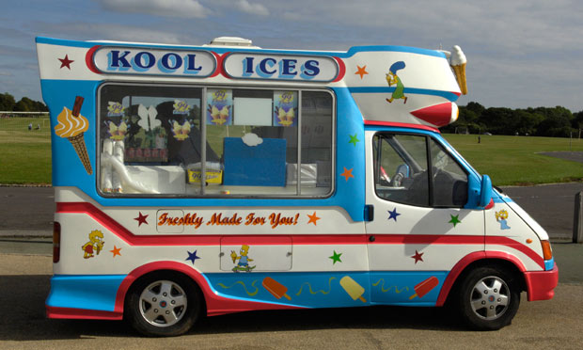
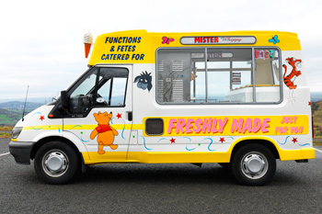
I Feel The Need, The Needs For Freeze
Lark Ices Van
Stannister Dairy Van
Winner!
The Lark Ices van can travel at a top speed of 45mph and is 15 miles from the concert venue.
The Stannister Dairy van can travel at a top speed of 40mph and is 12 miles from the concert venue.
Which van will get there first?
The Lark Ices van takes 20 minutes to get there and the Stannister Dairy van takes 18 minutes.

