Slide 1
Homes Under The Hammer Maths

Slide 2
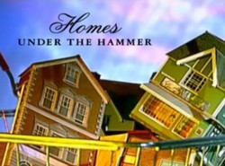
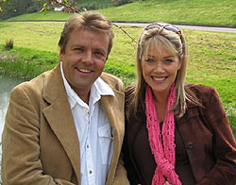
Homes Under The Hammer
If you've never seen this daytime television gem, then what happens is that people buy a property in an auction, do it up, then sell or rent it.
Lucy and Martin interview them before and after the renovation and estate agents value the property before and after.
The aim is to make a profit!

Slide 3
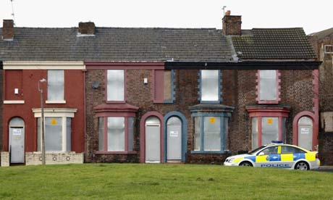
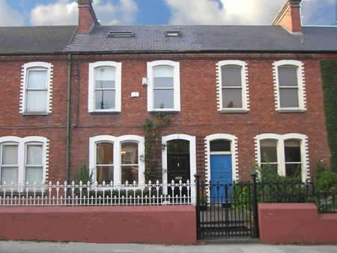
House 1
Before:
After:
Cost:
Auction - £35,000
Labour - £6,500
Kitchen - £2,500
Bathroom - £3,000
Flooring - £1,250
Other - £750
Valued:
£55,000
Will they make a profit?
What percentage profit/loss have they made?

Slide 4
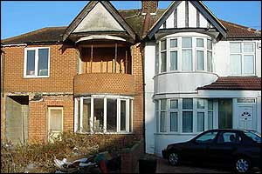
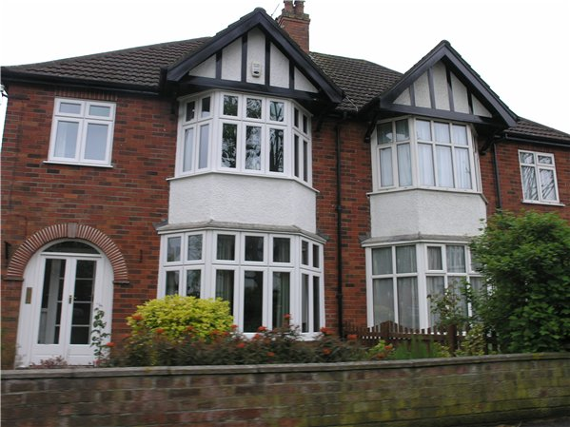
House 2
Before:
After:
Cost:
Auction - £148,000
Labour - £11,200
Kitchen - £4,700
Windows - £3,900
Bathrooms - £5,630
Carpets/Flooring - £5,350
Other - £1,290
Valued:
£175,000
Will they make a profit?
What percentage profit/loss have they made?

Slide 5
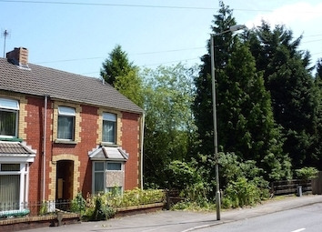
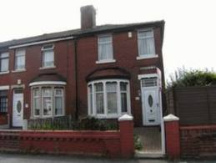
House 3
Before:
After:
Cost:
Auction - £173,250
Labour - £15,530
Kitchen - £4,215
Bathroom - £3,420
Carpets/Flooring - £3,140
Garage - £12,060
Garden - £3,125
Other - £1,023
Valued:
£249,950
Will they make a profit?
What percentage profit/loss have they made?

Slide 6
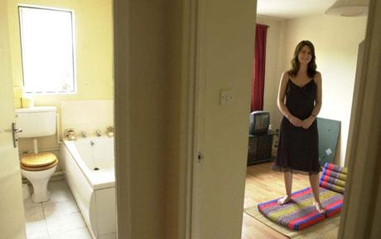
Flat 1
The lady in the picture bought this studio flat, costing:
Auction - £95,000
Decoration - £550
Carpet/Flooring - £1,240
Cleaning - £475
She rents the flat for £725 pcm (per calendar month).
She bought it with cash (so she pays no interest on it) - how long until she gets all her money back?

