Slide 1
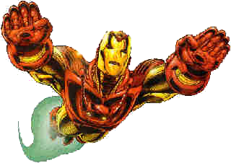
Ironman's Pythagoras and Trigonometry Problems
Help Ironman perform the calculations he needs to apprehend the villains in each case.

Slide 2
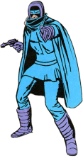
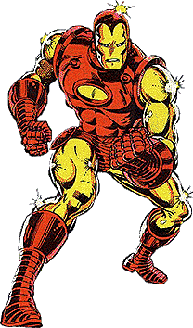
Situation 1:
Ironman is looking up to the top of a tower at Phantom. The tower is 114 metres tall and Ironman is 400 metres from the tower.
·How far does he have to fly to get to the top of the tower?
·If he flies at 40 metres per second, how long will it take him?
·What is the angle of elevation Ironman has to fly along?
Phantom
?
114m
Ironman
400m

Slide 3
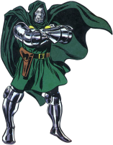
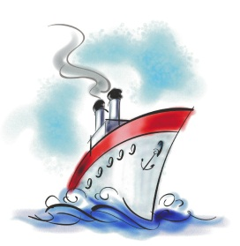
Situation 2:
Ironman is on top of a cliff that is 75 metres high looking at Dr Doom's ship which is 5 kilometres away because it's moored at an island on his map.
·How far does he have to fly to get to the ship?
·If he flies at 60 metres per second, how long will it take him?
·What is the angle of elevation that Ironman flies along?
Ironman
?
75m
Dr Doom
5km

Slide 4
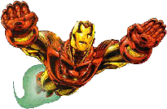
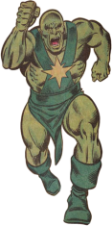
Situation 3:
Ironman has flown 12 kilometres and is immediately above Radioactive Man who was 7 kilometres from where Ironman began his flight.
·What is Ironman's altitude?
·At what angle did Ironman fly from the windmill?
Ironman
12km
?
Radioactive Man
7km

Slide 5
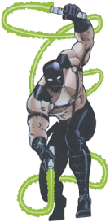
Situation 4:
Ironman has flown 23 kilometres from a power station and is immediately above Whiplash. Ironman's altimeter says that he is 6 kilometres up.
·How far has Ironman flown?
·At what angle did Ironman fly from the power station?
Ironman
23km
6km
Power Station
?
Whiplash

