Slide 1
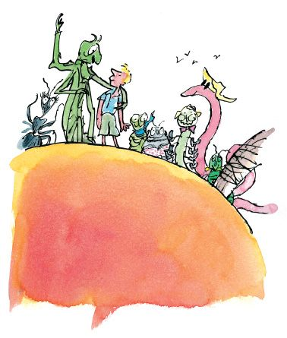
James’ Giant Peach Challenge
Mathematics

Slide 2
James’ Giant Peach Challenge
James’ peach weighs 5.25g is 5cm wide and 60mm tall.
If James’ peach doubles in size every 30 seconds. How heavy, wide and tall would it be after...
2 minutes.
5 minutes.
10 minutes.
1 hour.

Slide 3
Up, up and away!
“I’m going to take a long silk string,” James went on, “and I’m going to loop one end of it round the seagulls neck. Then I’m going to tie the other end to the stem of the peach…then I’m going to get another seagull and do the same thing again, then another and another…”
In the end, it took the combined lift of 502 seagulls to get the Giant Peach airborne.
If each seagull needed 50m of silk for it’s tether and the silk worm produced 10m of silk per minute. How long would it take for enough silk to be produced for 502 seagulls?
First, find out how long it would take to produce enough silk for:
1 seagull.
10 seagulls.
100 seagulls.
200 seagulls.

Slide 4
Arms and Legs
James shares the peach with many different animals. All of the insects have 6 legs; the centipedes have 100 legs and the humans have two!
If there were 136 legs. How many insects, centipedes and humans could there be?
What about if there were…
726 legs?
1,254 legs?
Remember:
There may be more than one way to solve these problems!

