Slide 1
LOUS
TWO-WAY TABLES

Slide 2
Wolverine's Table
Fill in the blanks in Wolverine's two-way table of the people he knows:
 | Mutant | Human | Alien | Total
Good |  | 43 |  | 72
Bad | 84 |  | 35
Total | 111 | 52 |  | 200
Use the table to answer the questions.
1. What is the probability of picking a mutant at random from the people Wolverine knows?
2. What's the probability of picking a good human?
3. What is the probability of picking someone who is bad?
Challenge:
4. Which category of individual has a 1% chance of being selected?

Slide 3
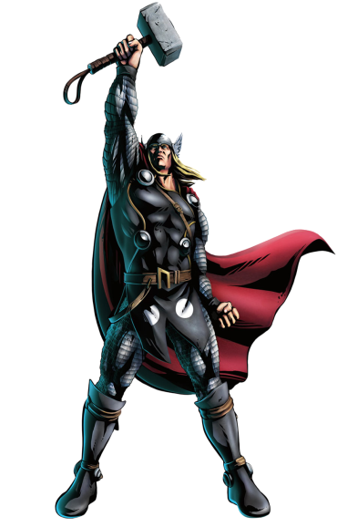
Thor's Table
Thor's been too busy defending Asgard to create a two-way table. Using the information below can you complete one for him and answer the questions?
He fought 100 aliens and humans, both male and female.
He fought 68 aliens in total of which 49 were male.
He fought 23 females in total.
1. What is the probability of picking a female at random?
2. What is the probability of picking a female alien?
3. What is the probability of picking a human?
Challenge:
4. Thor claims that more than three quarters of his fights are against males. Is he right? Explain your answer.

