Slide 1
Th
H
T
U
Th
H
T
U

Slide 2
Th
H
T
U
Th
H
T
U

Slide 3
Name: ___________________ Date:
Can you make the numbers?
Colour the squares to make the numbers:
4
1
7
9
10
20

Slide 4
What numbers are shown?
Write the correct number in the box:

Slide 5
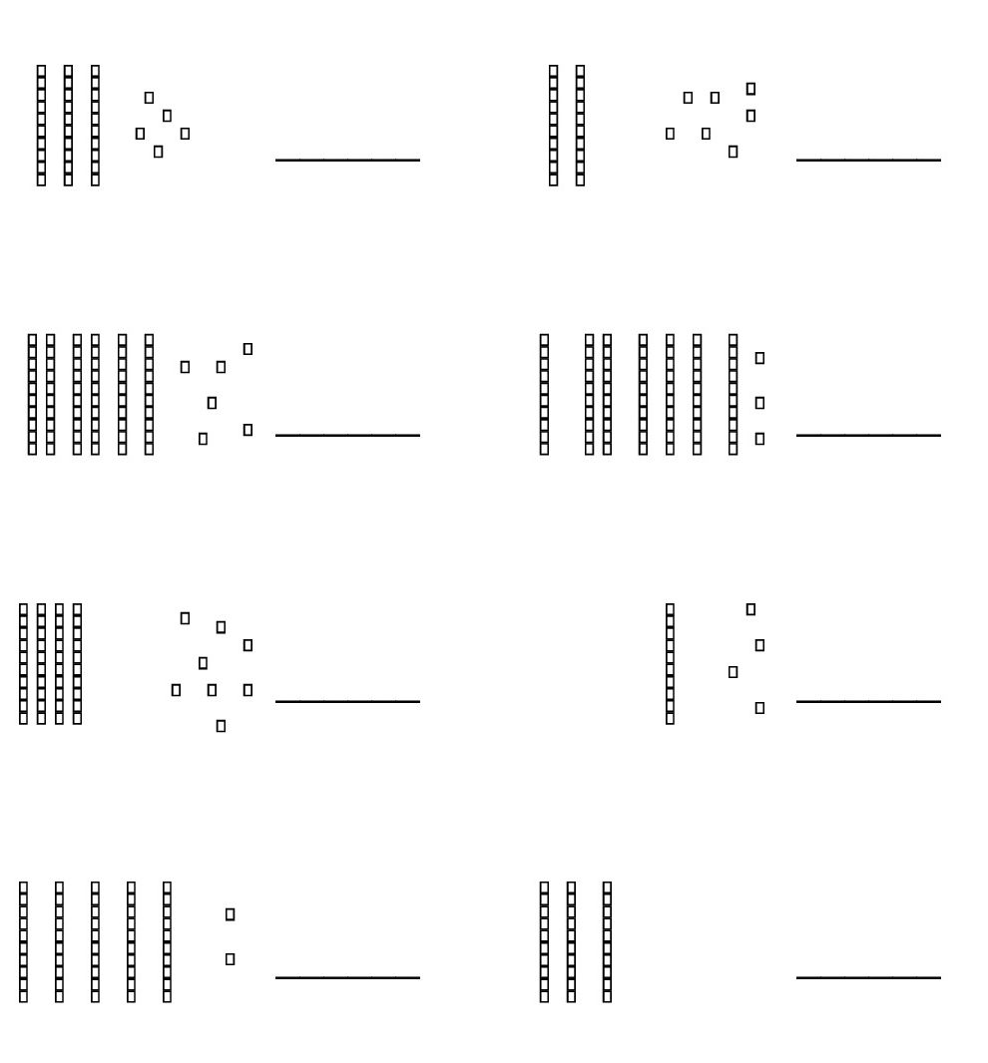
Name: ___________________ Date:
What numbers are shown?
Write the correct number on the line:
I know the value of each digit in a 2 digit number

Slide 6
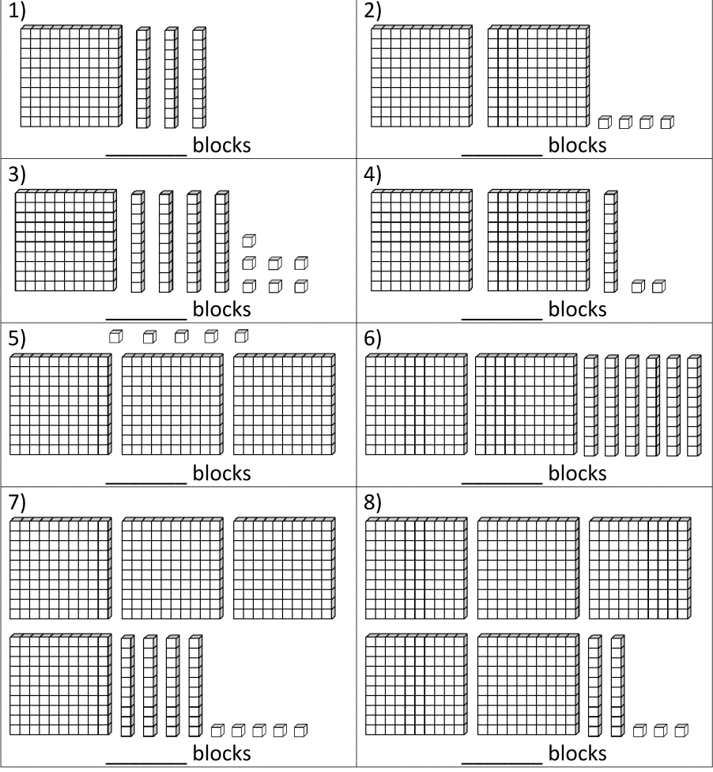
Name: ___________________ Date:
Write the correct number on the line:
I know the value of each digit in a 3 digit number

Slide 7
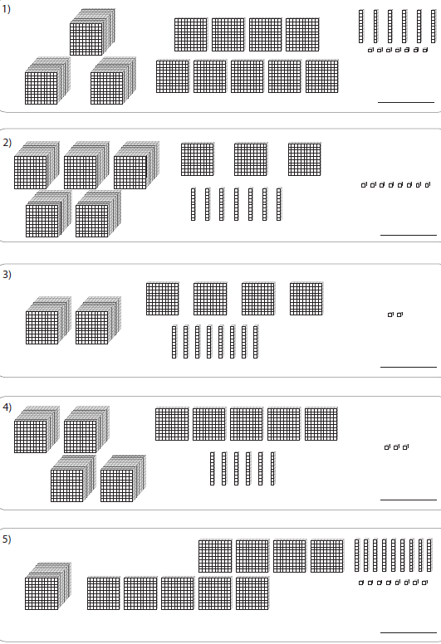
Name: ___________________ Date:
Write the correct number on the line:
I know the value of each digit in a 4 digit number

Slide 8
I can identify 2 digit numbers in word form
Name: ___________________ Date:
Write the words in numerals:
1) seventy-nine _______
2) forty-five _______
3) twenty-six _______
4) ninety-three _______
5) sixty-seven _______
6) eighty _______
7) fifty-eight _______
8) nineteen _______
9) thirty _______
10) sixty-eight _______
11) thirty-one _______
12) ninety _______
13) ninety-five _______
14) seventy-four _______
15) twelve _______
Challenge:
three hundred and eighty-one
_______

Slide 9
I can write 2 digit numbers in word form
Name: _____________________ Date:
Write the numbers in words:
1) 97
2) 54
3) 62
4) 76
6) 85
7) 58
8) 19
9) 10
Challenge: 120

Slide 10
I can identify 3 digit numbers in word form
Name: ______________________________ Date:
Write the words in numerals:
1) three hundred and eighty-one _______
2) six hundred and eighty-four _______
3) eight hundred and twenty-two _______
4) nine hundred and thirty _______
5) five hundred and twenty-five _______
6) seven hundred and sixty-six _______
7) nine hundred and forty-eight _______
8) one hundred and seventy-one _______
9) four hundred and seven _______
10) one hundred and nineteen _______
11) two hundred and five _______
12) two hundred and ninety-one _______
13) eight hundred and fifty-nine _______
Challenge: two thousand, six hundred and forty

Slide 11
I can write 3 digit numbers in word form
Name: _____________________ Date:
Write the numbers in words:
1) 100
2) 250
3) 375
4) 501
6) 915
Challenge: 1265

Slide 12
I can identify 4 digit numbers in word form
Name: ______________________________ Date:
Write the words in numerals:
1) two thousand, six hundred and forty _____________
2) six thousand, four hundred and sixty-six _____________
3) three thousand, six hundred and three _____________
4) two thousand, and twenty-nine _____________
5) eight thousand, nine hundred and seventy-six _____________
6) nine thousand, one hundred and one _____________
7) four thousand, five hundred and thirty-one _____________
8) three thousand, three hundred and fifty-nine _____________
9) seven thousand, nine hundred and seventy-two_____________
10) eight thousand, one hundred and fifty-two _____________

Slide 13
I can write 4 digit numbers in word form
Name: _____________________ Date:
Write the numbers in words:
1) 5000
2) 2250
3) 3175
4) 5109
6) 9002

Slide 14
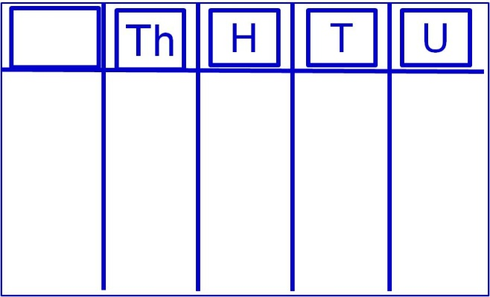
Super Challenge!
What is the fifth column in the Th, H, T, U grid called?
Can you write three numbers that include this column?
Can you write one of these numbers in words?

Slide 15
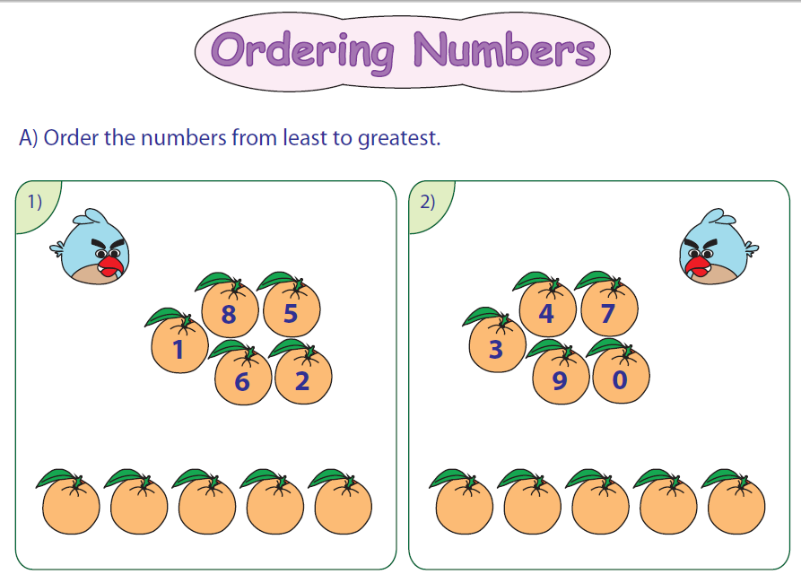
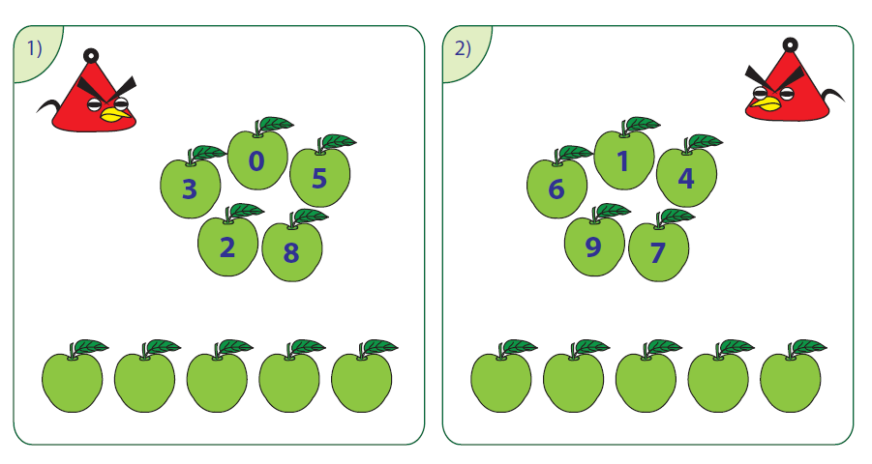
Name: ___________________ Date:

Slide 16
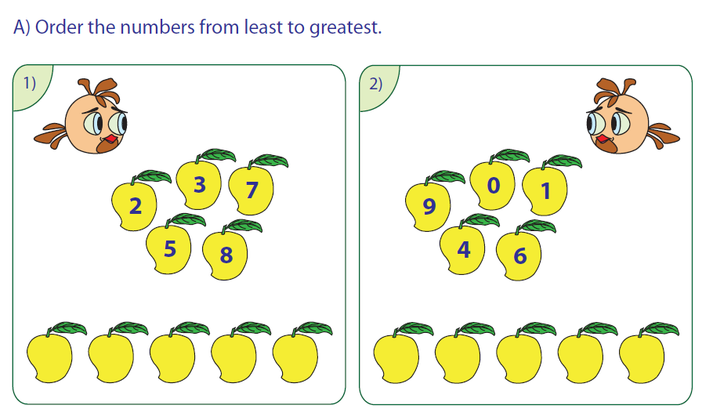
Circle the biggest number:
5, 7, 1, 2
1, 10, 5, 8
10, 13, 15, 11
12, 20, 17, 10
21, 25, 26, 23
29, 24, 22, 27

Slide 17
Name: ___________________ Date:
I can order 2 digit numbers
Challenge:

Slide 18
Name: ___________________ Date:
I can order 3 digit numbers
Challenge:

Slide 19
Name: ___________________ Date:
I can order 4 digit numbers
Challenge:

Slide 20
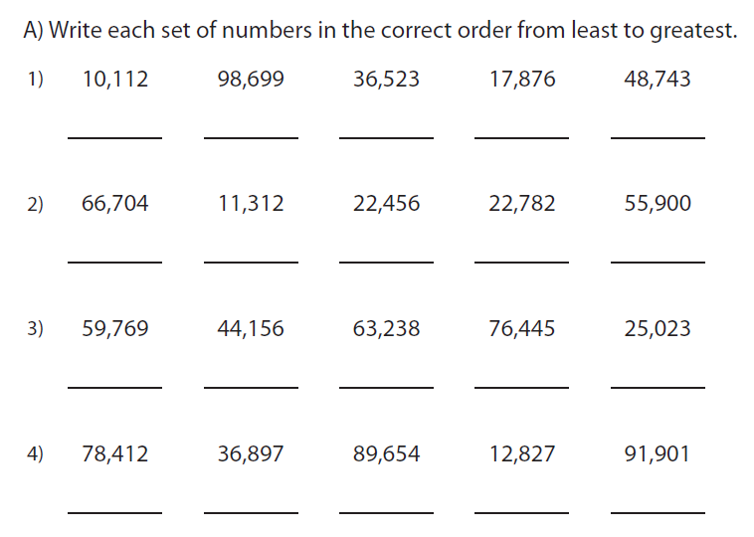
Name: ___________________ Date:
I can order 5 digit numbers

