Slide 1
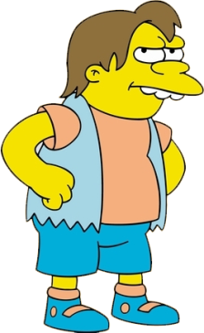
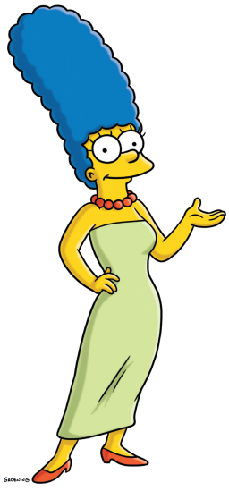
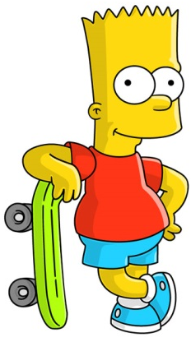
Simpsons Fractions

Slide 2
½ of 10 is

Slide 3
¼ of 12 is

Slide 4
1/3 of 21 is

Slide 5
of 12 is 6

Slide 6
of 30 is 10

Slide 7
of 25 is 5

Slide 8
½ of is 3

Slide 9
¼ of is 8

Slide 10
1/6 of is 5

Slide 11
of is 5

