Slide 1
James Bond returns in:
https://www.youtube.com/watch?v=z4UDNzXD3qA

Slide 2
The back story…
Criminal group Spectre formerly headed by the infamous Ernst Stavro Blofeld are back on the scene and Bond is looking to halt their plans. Blofeld’s frontman Franz Oberhauser is proving to be a worthy adversary for Bond, so you will need to ensure that you get everything right.
Can you help Bond thwart Spectre’s plans?

Slide 3
Issue 1
Q branch have given Bond a bomb distributing robot that has 3 settings:
$$a:\left({2 \atop 5}\right)$$
$$b:\left({1 \atop 3}\right)$$
$$c:\left({−4 \atop −3}\right)$$
Can you help Bond calculate some resultant vectors and their magnitudes using these three settings?

Slide 4

Issue 1 – resultant vectors and their magnitudes:
$a:\left({2 \atop 5}\right)$ $b:\left({1 \atop 3}\right)$ $c:\left({−4 \atop −3}\right)$
$a+b$
$a−b$
$3a$
$2a+3b$
$a+b+c$
$2b−c$
$a+4c$
$2a−b−3c$
$\left({3 \atop 8}\right)$, $\sqrt{73}=8.54 3sf$
$\left({1 \atop 2}\right)$, $\sqrt{5}=2.24 3sf$
$\left({6 \atop 15}\right)$, $\sqrt{261}=16.2 3sf$
$\left({7 \atop 19}\right)$, $\sqrt{410}=20.2 3sf$
$\left({−1 \atop 5}\right)$, $\sqrt{26}=5.10 3sf$
$\left({6 \atop 9}\right)$, $\sqrt{117}=10.8 3sf$
$\left({−14 \atop −7}\right)$, $\sqrt{245}=15.7 3sf$
$\left({15 \atop 16}\right)$, $\sqrt{481}=21.9 3sf$

Slide 5
Issue 2:
Bond has to guide drones to the various places that Oberhauser and Blofeld have been spotted.
The drone provided by Q Branch has two settings but Bond can use multiple amounts of each setting as well as fractional amounts.
Help Bond program the drone to get to each location.

Slide 6
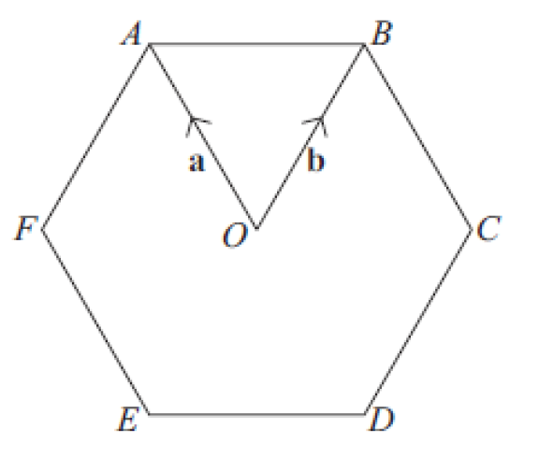
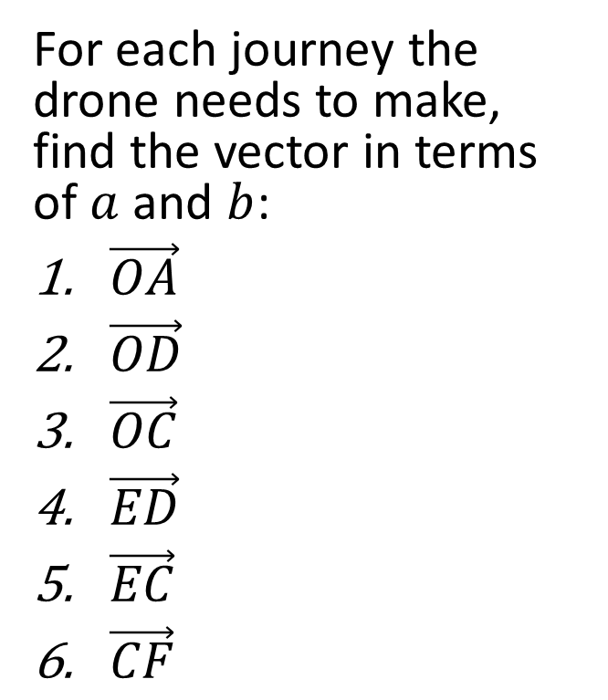
Issue 2:
For each journey the drone needs to make, find the vector in terms of $a$ and $b$:
$\vec{OA}$
$\vec{OD}$
$\vec{OC}$
$\vec{ED}$
$\vec{EC}$
$\vec{CF}$
$$a$$
$$−a$$
$$b−a$$
$$b−a$$
$$2b−a$$
$2a−2b$ or $2b−2a$

Slide 7
Issue 3:
Oberhauser and Blofeld are been cornered in two separate locations having escaped the previous drone attacks.
Can you programme the two separate drones to target the two locations?
Read all the information very carefully – we can’t afford to waste this chance!

Slide 8
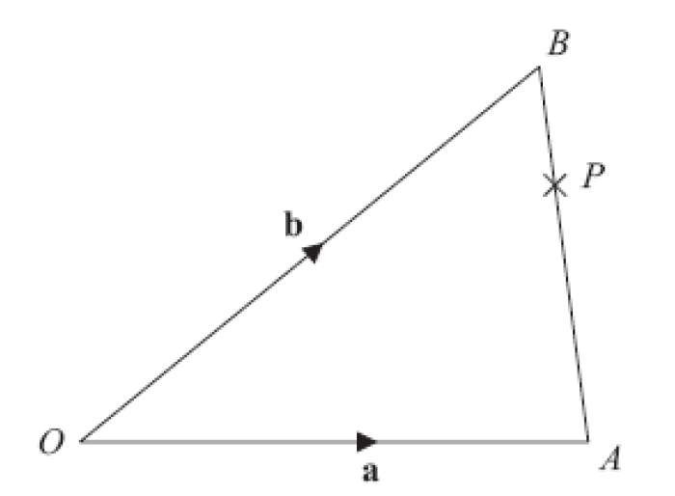
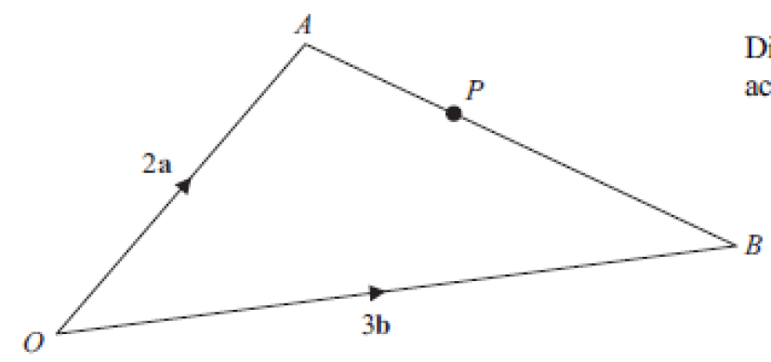


Issue 3 (in terms of $a$ and $b$):
Franz Oberhauser:
$$\vec{AP}=3\vec{PB}$$
Find $\vec{OP}$
Ernst Stavro Blofeld:
$\vec{AP}:\vec{PB}$ is $2:3$
Find $\vec{AP}$
$$\frac{6}{5}b−\frac{4}{5}a$$
$$\frac{1}{4}a+\frac{3}{4}b$$

Slide 9
Another Spectre plan foiled…
Bond will return…

