Slide 1
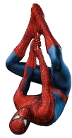
Spiderman Bearings

Slide 2
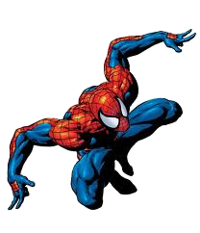
Spiderman Bearings
Spidey is on the lookout for criminals.
Can you help him by giving him the three figure bearing for each on the grid?

Slide 3
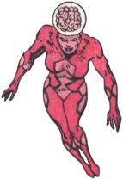
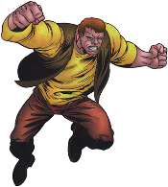
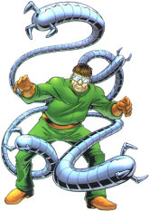
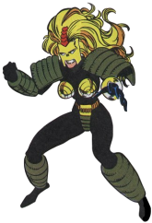
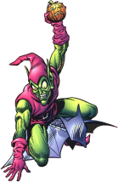
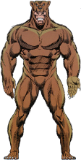
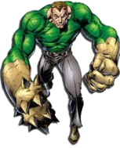
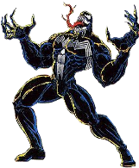
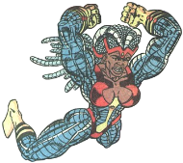
Beetle
Juggernaut
Mindblast
Ox
N
Dr Octopus
Whiplash
Green Goblin
Carnage
Boomerang
Rhino
Grizzly
Sandman
Venom
Spot
Shriek
Knockout

Slide 4
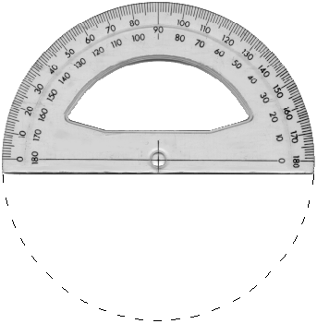
Beetle
Juggernaut
Mindblast
Ox
N
Dr Octopus
Whiplash
Green Goblin
Carnage
Boomerang
Rhino
Grizzly
Sandman
Venom
Spot
Shriek
Knockout

Slide 5
008º
346º
030º
320º
Beetle
Juggernaut
Mindblast
Ox
N
301º
055º
Dr Octopus
Whiplash
270º
090º
Green Goblin
258º
Carnage
Boomerang
117º
Rhino
220º
Grizzly
Sandman
143º
127º
Venom
162º
204º
Spot
Shriek
Knockout
180º

