Slide 1
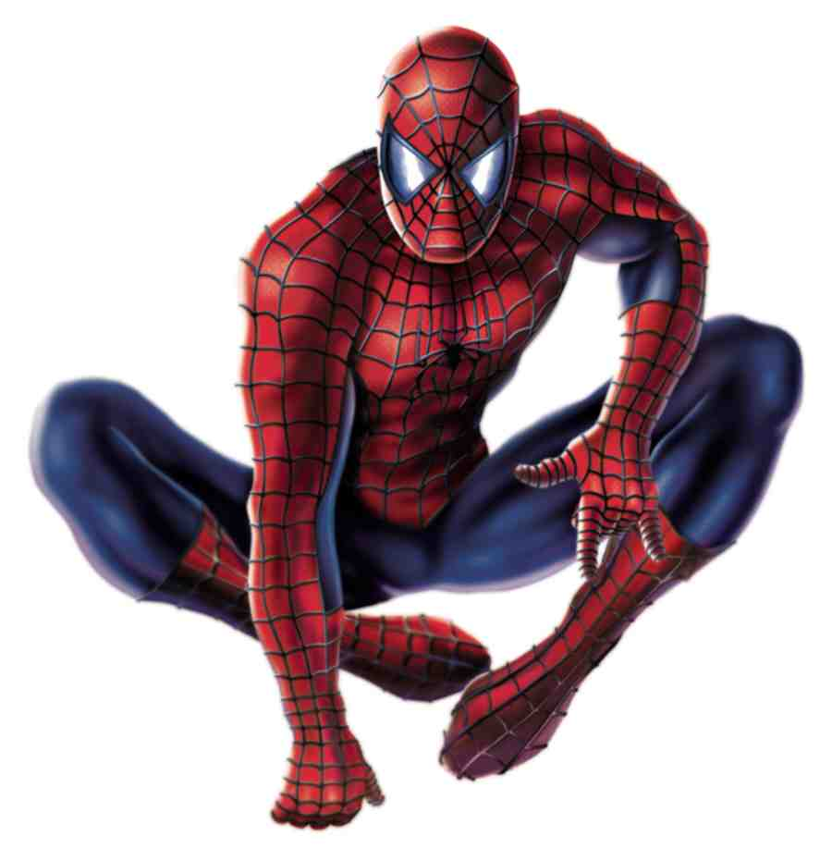
Spiderman Loci
Spidey needs to keep out of the reach of all his enemies.
Show the set of points where he can be in each situation without being caught by each villain's weaponry.

Slide 2
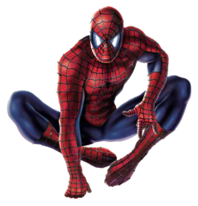
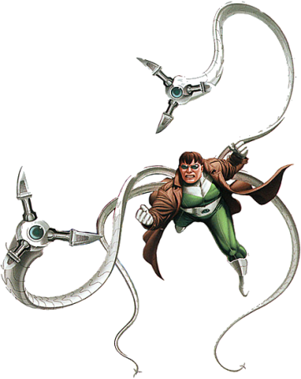
Situation 1 - In A Warehouse
Doctor Octopus
Use a scale of 1cm:1m
Doctor Octopus' tentacles reach 4 metres.

Slide 3
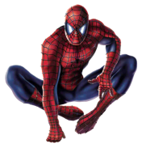
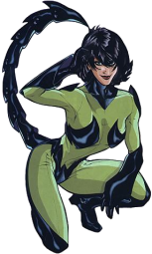
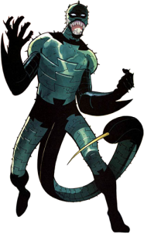
Situation 2 - Avoiding Stings
Scorpia
Scorpion
Use a scale of 1cm:1m
Spidey has to bisect Scorpion and Scorpia to avoid both their stings.

Slide 4
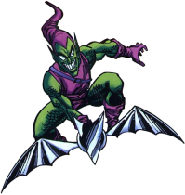
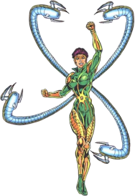
Situation 3 - Industrial Complex
Green Goblin
Doctor Octopus 2
Warehouse
Use a scale of 1cm:1m
Spidey has to avoid The Green Goblin who is patrolling 1 metre around the outside of the warehouse and Doctor Octopus 2 whose tentacles reach 3 metres.

