Slide 1
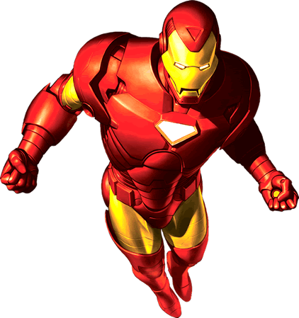
Superhero Co-ordinate Pythagoras
With
Superman
Iron Man

Slide 2
The Contessa
Doomsday
Superman's Base
Maxima
Lex Luther
1. Base to Doomsday
2. Doomsday to The Contessa
3. The Contessa to Maxima
4. Maxima to Lex Luther

Slide 3
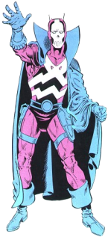
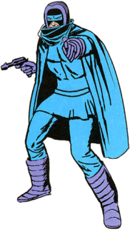
(5,8)
Doctor Demonicus
Blizzard
(-5,4)
Iron Man's Base
(7,-1)
Phantom
Punisher
(-1,-5)
1. Base to Phantom
2. Phantom to Punisher
3. Punisher to Blizzard
4. Blizzard to Doctor Demonicus

