Slide 1
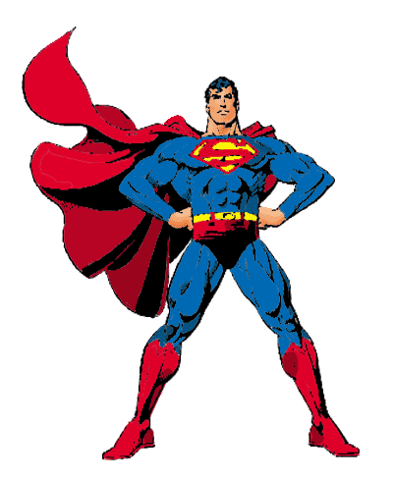
Superman Bearings

Slide 2
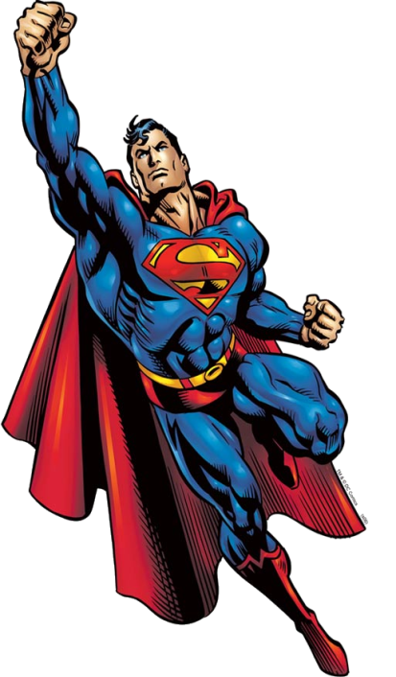
Superman Bearings
Superman has to fly around his local area catching criminals.
He obviously flies in a straight line between cities and towns as that is the quickest route.
Use bearings and a scale of 1cm:50km to describe Superman's journey on a particularly busy day for crime fighting.

Slide 3
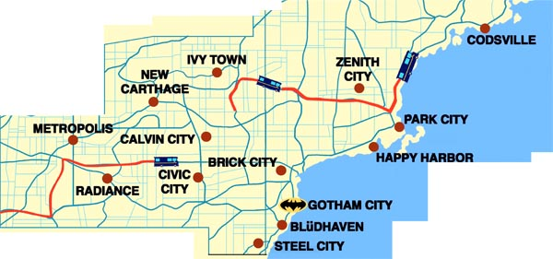
Superman's Neighbourhood:

Slide 4
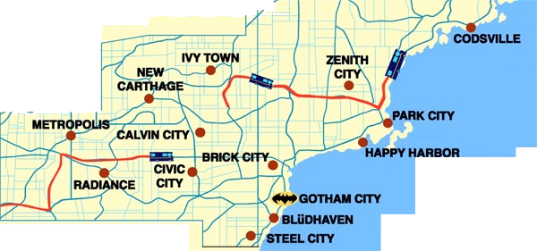
Superman's Journey:
Leg | Start | Finish | Distance | Bearing
1 | Metropolis |  | 220km | 107o
2 |  | Ivy Town
3 | Ivy Town |  | 240km | 096o
4 |  | Steel City
5 | Steel City |  | 200km | 333o
6 |  | Metropolis

Slide 5
Superman's Journey Answers:
Leg | Start | Finish | Distance | Bearing
1 | Metropolis | Civic City | 220km | 107o
2 | Civic City | Ivy Town | 180km | 010o
3 | Ivy Town | Zenith City | 240km | 096o
4 | Zenith City | Steel City | 310km | 213o
5 | Steel City | Calvin City | 200km | 333o
6 | Calvin City | Metropolis | 225km | 270o

