Slide 1
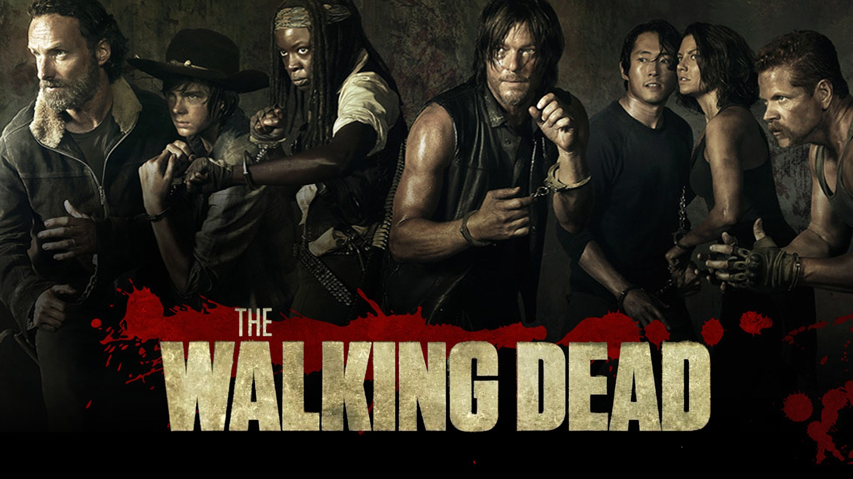
Congruence and Similarity

Slide 2
The Back Story
Aptly named Deputy Nick Crimes has just woken from a coma to discover that Earth is in the midst of a zombie apocalypse. The "shufflers" and "nibblers", as the zombies are known, are continually looking for "fresh meat" in the form of human flesh.
Deputy Crimes must find refuge along with fellow survivors from the shufflers and nibblers.
Can you help?

Slide 3
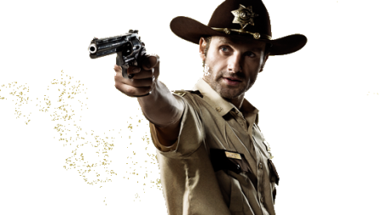
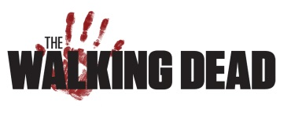
Situation 1
Deputy Crimes has been informed that any warehouses that are congruent to Shape A are safe.
Which of the warehouses below can he go in safely?
D
C
A
B
E
F
G
H
J
I
Answers:
C, D, I, M
K
L
N
O
M

Slide 4
Situation 2
Deputy Crimes has been informed that any buildings that are similar to Shape A are safe.
Which of the buildings below can he go in safely?
A
B
E
C
D
G
F
Answers:
C, E, H, J
I
H
J

Slide 5
Situation 3
Deputy Crimes has been informed that any buildings that are similar to a cuboid of dimensions 3cm by 4cm by 5cm are safe. Which of the buildings below can he go in safely?
Building B:
Height: 9m
Width: 11m
Length: 15m
Building A
6m
8m
10m
Building C:
Height: 12m
Width: 16m
Length: 20m
Building D:
Height: 7.5m
Width: 10m
Length: 12.5m
Answers:
A, C, D
Building E
4.5m
5.5m
7.5m

Slide 6
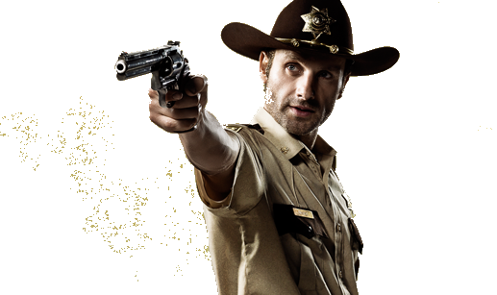
Situation 4
Deputy Crimes knows that the picture of the triangle and the silhouette of the building are similar. He wants to know the missing lengths on both triangles and the scale factor of enlargement.
8cm
9cm
28m
31.5m
6cm
Scale Factor: 3.5
21m

