Slide 1
Bearings

Slide 2
The Back Story
Aptly named Deputy Nick Crimes has just woken from a coma to discover that Earth is in the midst of a zombie apocalypse. The "shufflers" and "nibblers", as the zombies are known, are continually looking for "fresh meat" in the form of human flesh.
Deputy Crimes, along with fellow survivors, must avoid shufflers and nibblers.
Can you help?

Slide 3
Journey 1
It is safer to travel at night so Deputy Crimes needs very precise instructions and bearings in order to travel safely.
Describe each bearing and distance Crimes must travel.
Store
N
1km
Farm
Finish
Start
House

Slide 4
Journey 2
It is safer to travel at night so Deputy Crimes needs very precise instructions and bearings in order to travel safely.
Describe each bearing and distance Crimes must travel.
School
N
Start
1km
Medical Centre
Sports Stadium
Gas Station
Finish

Slide 5
Answers coming next

Slide 6
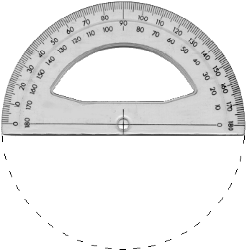
Journey 1
It is safer to travel at night so Deputy Crimes needs very precise instructions and bearings in order to travel safely.
Describe each bearing and distance Crimes must travel.
Store
N
1km
Farm
Finish
Start
House

Slide 7
Journey 1 - Answers
It is safer to travel at night so Deputy Crimes needs very precise instructions and bearings in order to travel safely.
Describe each bearing and distance Crimes must travel.
220º
Store
2km
N
1km
315º
Farm
4km
2km
270º
Finish
Start
House
3km
000º

Slide 8
Journey 2
It is safer to travel at night so Deputy Crimes needs very precise instructions and bearings in order to travel safely.
Describe each bearing and distance Crimes must travel.
School
N
Start
1km
Medical Centre
Sports Stadium
Gas Station
Finish

Slide 9
Journey 2 - Answers
It is safer to travel at night so Deputy Crimes needs very precise instructions and bearings in order to travel safely.
Describe each bearing and distance Crimes must travel.
205º
School
N
200º
Start
2km
1km
340º
Medical Centre
3.5km
4km
3km
Sports Stadium
2.5km
115º
Gas Station
Finish
295º

