Slide 1
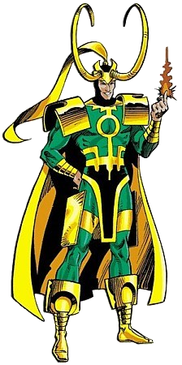
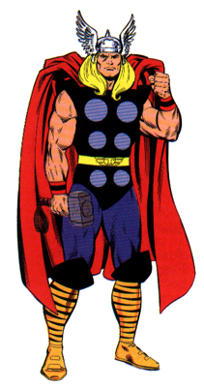
Thor and Loki
Thor and Loki are brothers, but Loki is continually battling to win the throne of Asgard from Thor. Loki has recruited numerous villains to fight for him, but they have to deal with Thor's trusted and extremely powerful hammer.

Slide 2
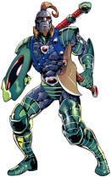
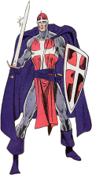
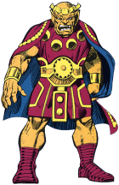
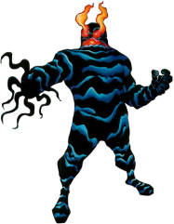
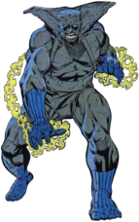
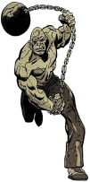
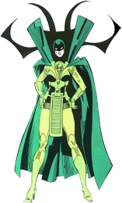
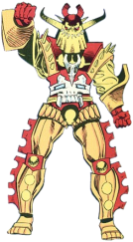
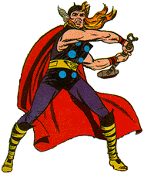
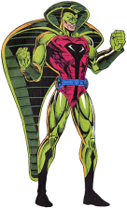
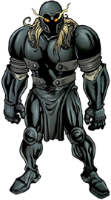
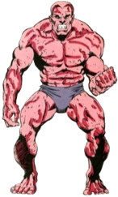
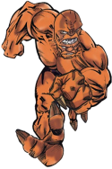
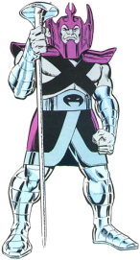
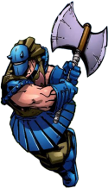
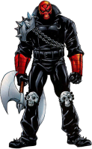
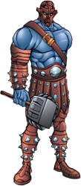
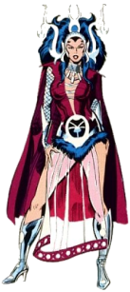
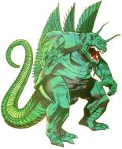
Battle 1
Twenty of Loki's recruits have surrounded Thor. His hammer will defeat anyone within 14 metres of Thor. Who will escape?
Scale on your worksheet: 1 centimetre = 2 metres
Ares
Dessak
Flame
Crusader
Geirrodor
Grey Gargoyle
Godstorm
Enchantress
Absorbing Man
Destroyer
Curse
Hela
Thor
Cobra
Grotesk
BiBeast
Lava Man
Grog
Executioner
Bloodaxe
Fafnir
Grendell
Kamilla

Slide 3
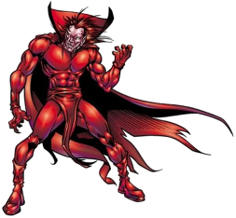
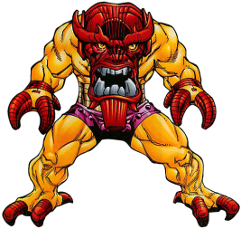
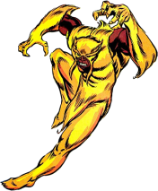
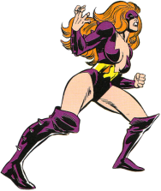
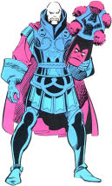
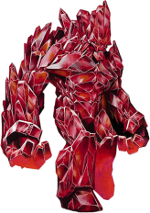
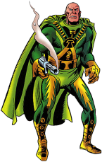
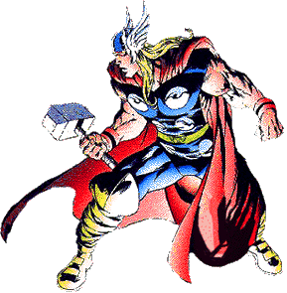
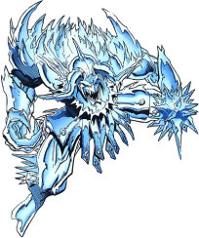
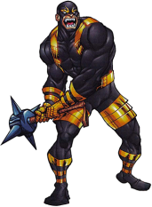
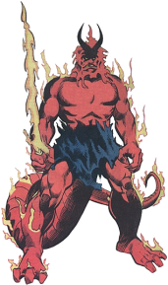
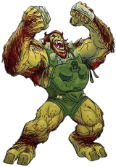
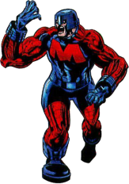
Battle 2
Fifteen more of Loki's recruits have surrounded Thor in a royal outbuilding. His hammer will defeat anyone within 4 metres of the outbuilding. Who will escape?
Scale on your worksheet: 1 centimetre = 1 metre
Pluto
Memphisto
Mongoose
Titania
Mangog
Man Beast
Xorr
Zarko
Lorelei
Thor
Megatak
Pentigaar
Tutinax
Surtur
Malekith
Ulik

Slide 4
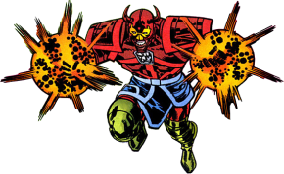
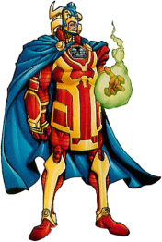
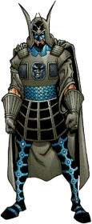
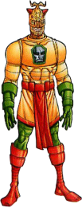
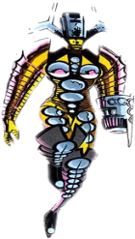
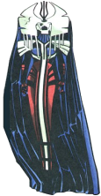
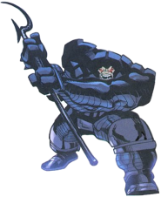
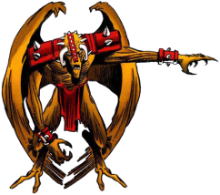
Battle 3
Two groups of Loki's recruits are preparing to attack. In order to defeat them before they reach him Thor must throw his trusty hammer exactly down the middle of the two groups. Accurately draw the exact line on which Thor must throw his hammer.
Scale on your worksheet: 1 centimetre = 1 metre
The Enchanters
The Dark Gods

Slide 5
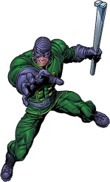
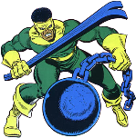
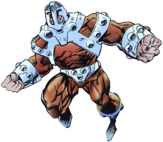
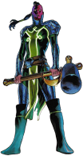
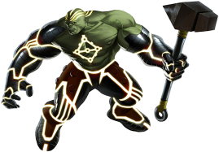
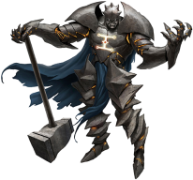
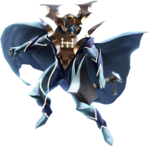
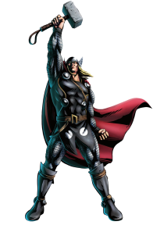
Battle 4
Two groups of Loki's recruits are preparing to attack. They are lining up to fight Thor on two fronts. Thor must throw his hammer down the middle to defeat them all at the same time.
Accurately draw the line on which Thor must throw his hammer.
Scale on your worksheet: 1 centimetre = 1 metre
The Wrecking Crew
The Worthy

Slide 6
Battle 5 - The Final Showdown
Loki's recruits have trapped Thor in the throne room. In order to defeat all of Loki's troops Thor must find an area where he is:
Within 5 metres of the throne.
Closer to the East wall than the South wall.
Nearer to the Gold Pillar than the Silver Pillar.
Find the area in which Thor must position himself in order to defeat Loki's army.
Scale on your worksheet: 1 centimetre = 1 metre

Slide 7
The Final Showdown Conditions:
Within 5 metres of the throne.
Closer to the East wall than the South wall.
Nearer to the Gold Pillar than the Silver Pillar.
North Wall
Throne
Silver Pillar
Bronze Pillar
West Wall
East Wall
North
Gold Pillar
South Wall

Slide 8
The Answers Follow...

Slide 9
Battle 1 - Answer
Twenty of Loki's recruits have surrounded Thor. His hammer will defeat anyone within 14 metres of Thor. Who will escape?
Scale on your worksheet: 1 centimetre = 2 metres
Ares
Dessak
Flame
Crusader
Geirrodor
Grey Gargoyle
Godstorm
Enchantress
Absorbing Man
Destroyer
Curse
Hela
Thor
Cobra
Grotesk
BiBeast
Lava Man
Grog
Executioner
Bloodaxe
Fafnir
Grendell
Kamilla

Slide 10
Battle 2 - Answer
Fifteen more of Loki's recruits have surrounded Thor in a royal outbuilding. His hammer will defeat anyone within 4 metres of the outbuilding. Who will escape?
Scale on your worksheet: 1 centimetre = 1 metre
Pluto
Memphisto
Mongoose
Titania
Mangog
Man Beast
Xorr
Zarko
Lorelei
Thor
Megatak
Pentigaar
Tutinax
Surtur
Malekith
Ulik

Slide 11
Battle 3 - Answer
Two groups of Loki's recruits are preparing to attack. In order to defeat them before they reach him Thor must throw his trusty hammer exactly down the middle of the two groups. Accurately draw the exact line on which Thor must throw his hammer.
Scale on your worksheet: 1 centimetre = 1 metre
The Enchanters
The Dark Gods

Slide 12
Battle 4 - Answer
Two groups of Loki's recruits are preparing to attack. They are lining up to fight Thor on two fronts. Thor must throw his hammer down the middle to defeat them all at the same time.
Accurately draw the line on which Thor must throw his hammer.
Scale on your worksheet: 1 centimetre = 1 metre
The Wrecking Crew
The Worthy

Slide 13
Battle 5 - The Final Showdown - Answer:
Within 5 metres of the throne.
Closer to the East wall than the South wall.
Nearer to the Gold Pillar than the Silver Pillar.
North Wall
This bit!
Throne
Silver Pillar
Bronze Pillar
West Wall
East Wall
North
Gold Pillar
South Wall

