Slide 1
Treehouse
Architecture Workshop

Slide 2
What is Architecture?
It’s the ‘design of buildings’.
What is an Architect?
The ‘person’ who designs buildings.

Slide 3
Who knows what and where this famous building is?
Big Ben and the Houses of Parliament in London!

Slide 4
Who knows what and where this famous structure is?
The Eiffel Tower in Paris, France!

Slide 5
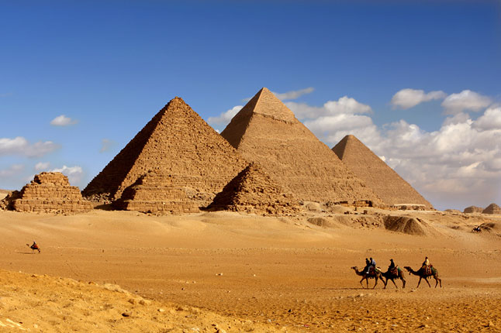
Who knows what and where this famous structure is?
The Great Pyramids of Giza in Egypt!

Slide 6
Who knows what and where this famous building is?
Sydney Opera House, Australia!

Slide 7
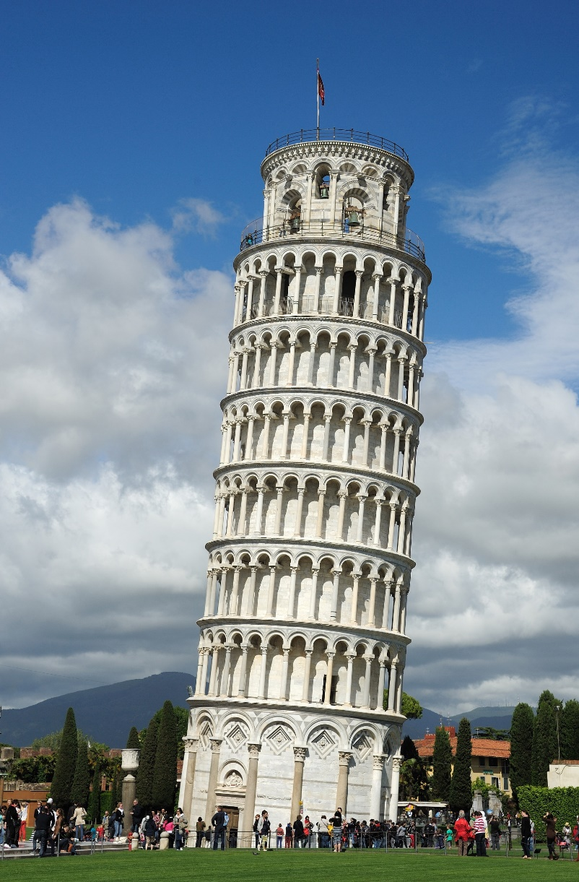
Who knows what and where this famous building is?
The Leaning Tower of Pisa in Italy!

Slide 8
I’m an Architect and my job is to design buildings!

Slide 9
This is a drawing of a building that I designed and what I wanted it to look like.

Slide 10
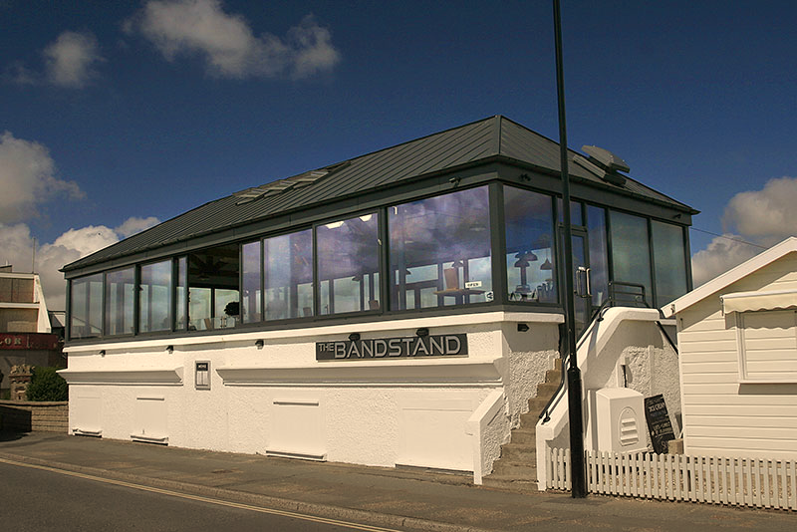
This is a photograph of what the building looked like after it was built!

Slide 11
A Client asks an Architect for a new building.
The Architect designs a new building with drawings and models of the ideas.
The Client picks the design they like.
The Architect helps to build it.

Slide 12
Today you are the pretend Architects.
You have been asked by your client to design a
TREEHOUSE!
Use drawings and models of your design to show your client!

Slide 13
PICK A CLIENT
3 Blind Mice
Old MacDonald the Farmer
Princess and the Pea
2 little Dicky Birds Peter and Paul
Incy Wincy Spider
2 little Speckled Frogs
4 Little Men in a Flying Saucer
Another Client of your choice

Slide 14
THINGS TO THINK ABOUT
Treehouse Design
What the Client WANTS
What SHAPE
How to get IN and OUT
BIG or SMALL
What the Client NEEDS
What it LOOKS like
The MATERIALS are used

Slide 15
THINK
DISCUSS
DRAW
MAKE
PRESENT
THINGS TO DO

Slide 16
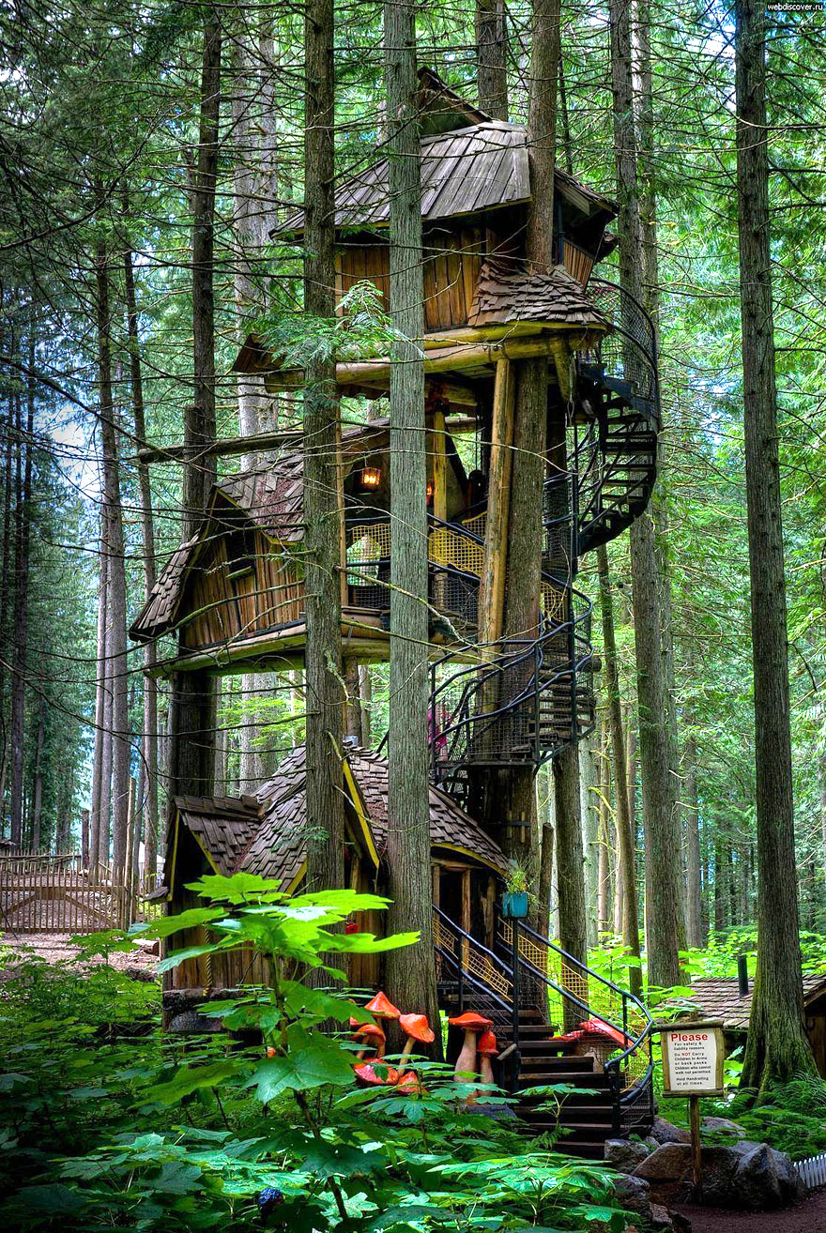
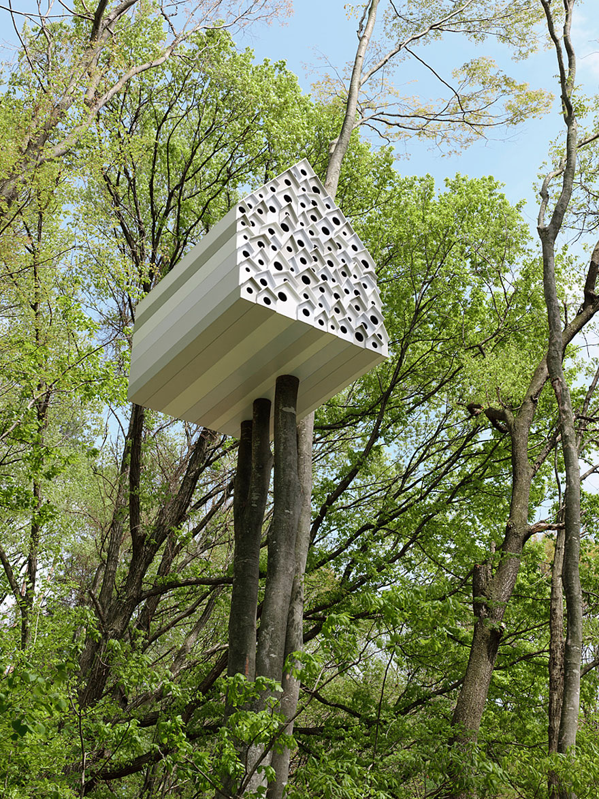
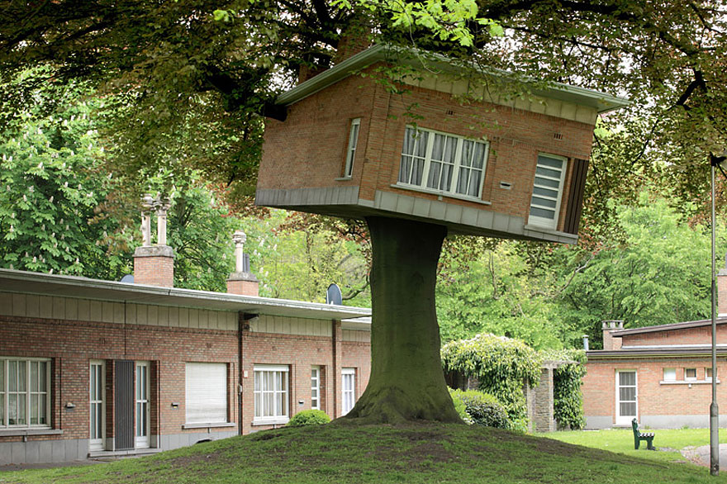
SOME IDEAS FOR YOU

Slide 17
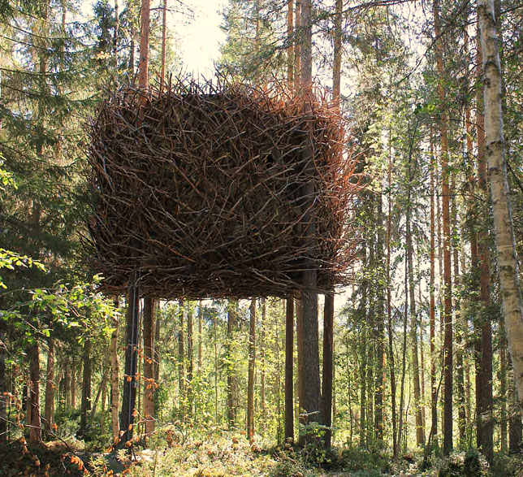
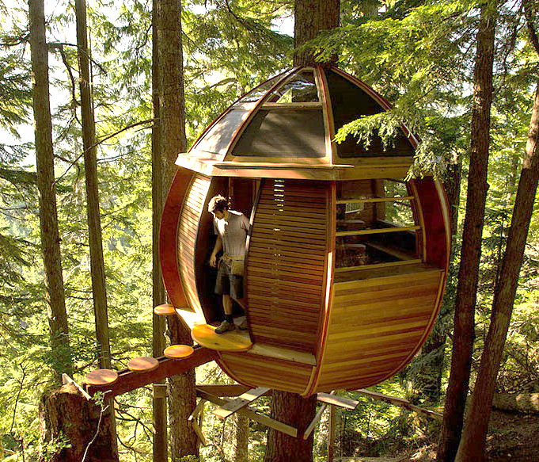
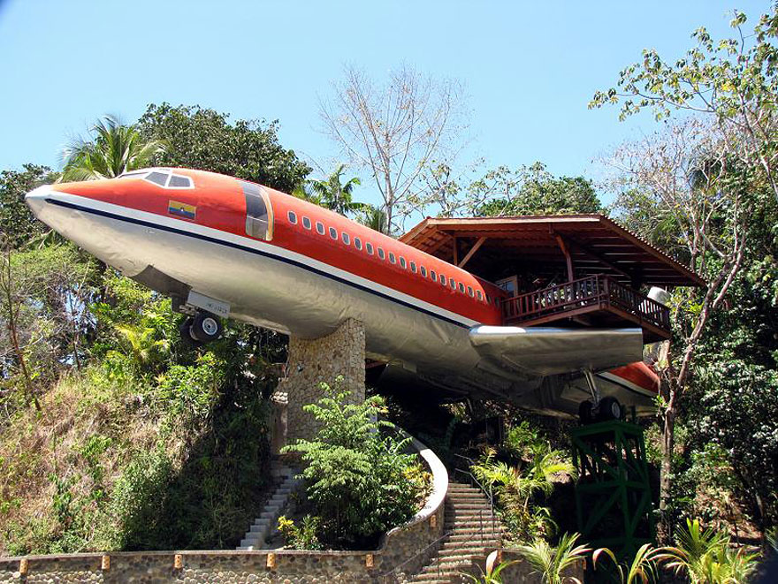
SOME IDEAS FOR YOU

Slide 18
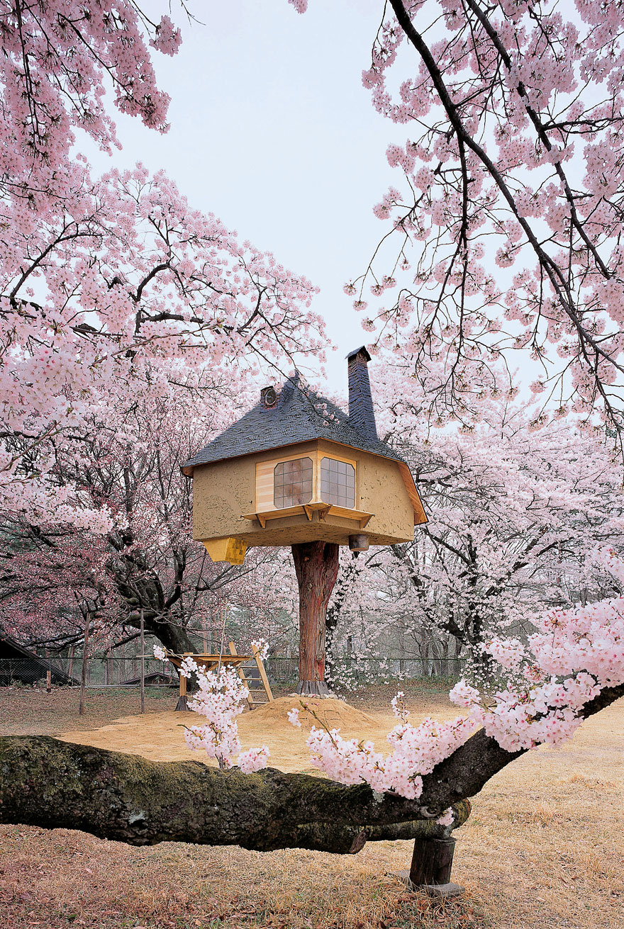
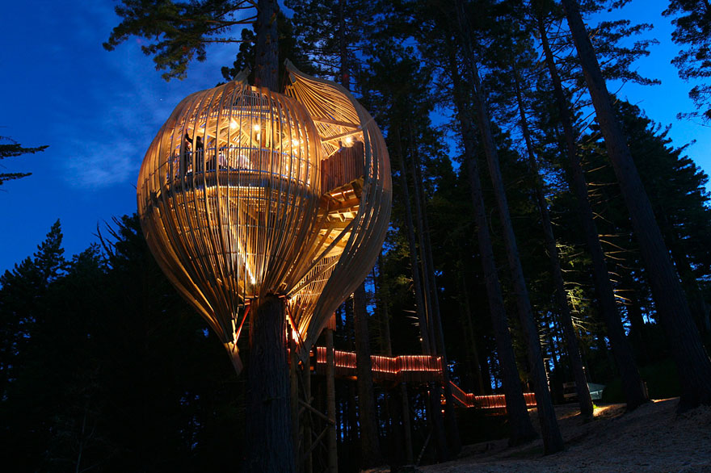
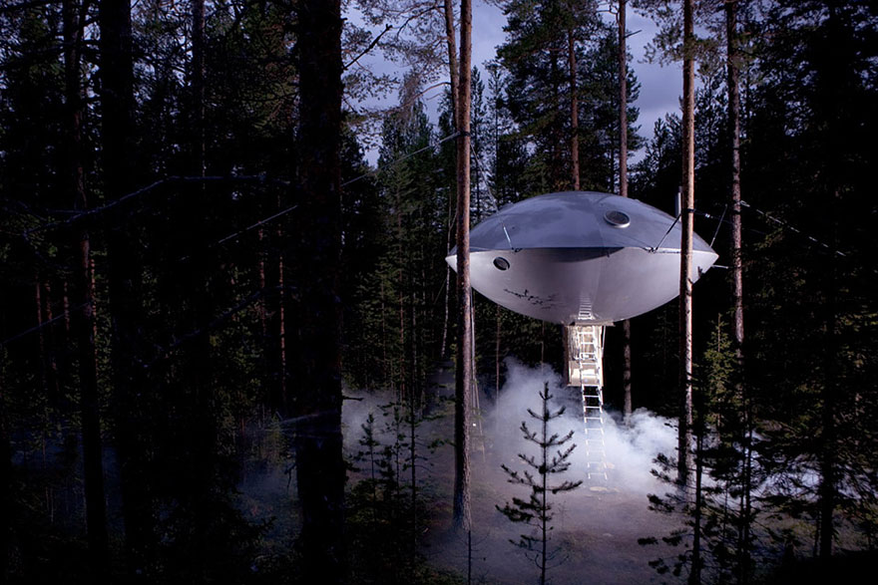
SOME IDEAS FOR YOU

Slide 19
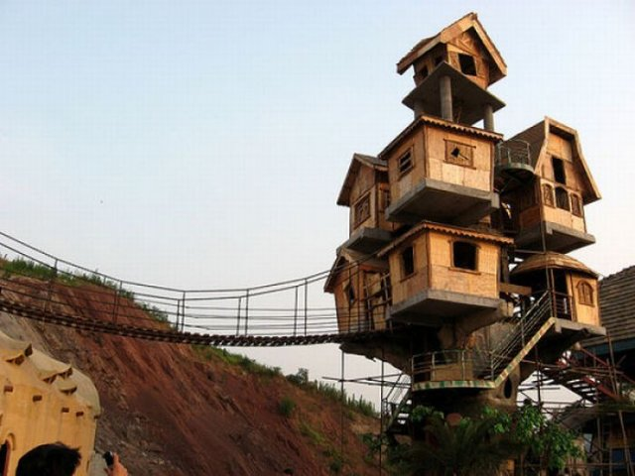
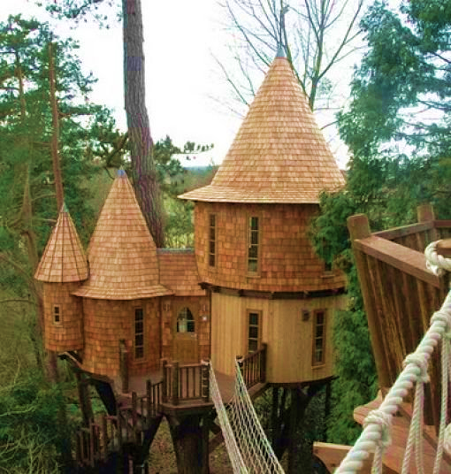
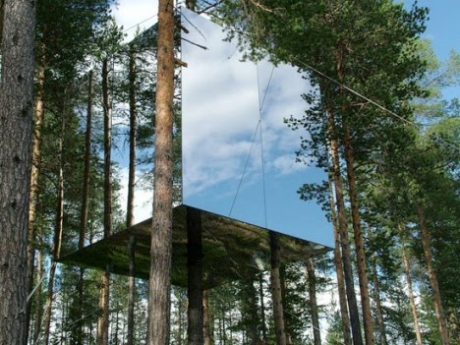
SOME IDEAS FOR YOU

Slide 20
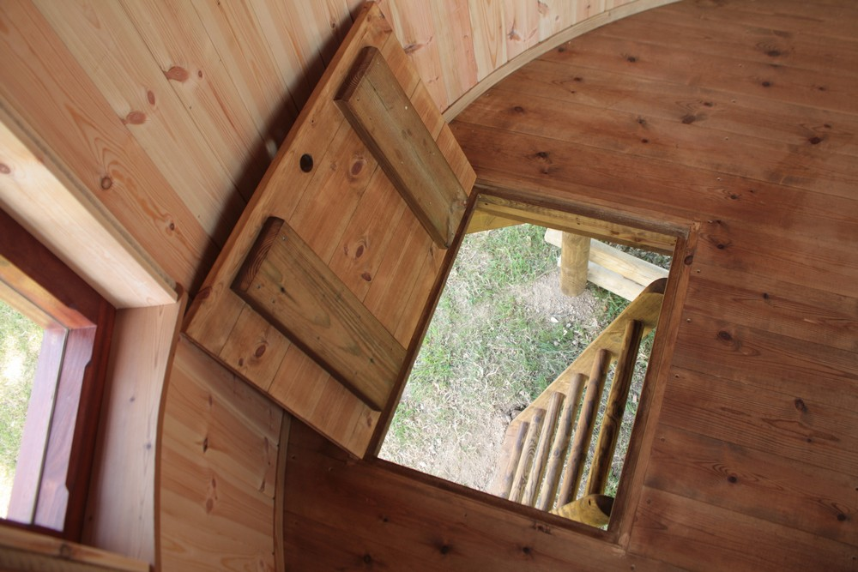
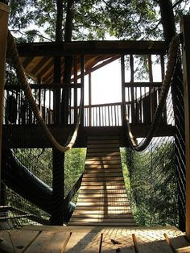
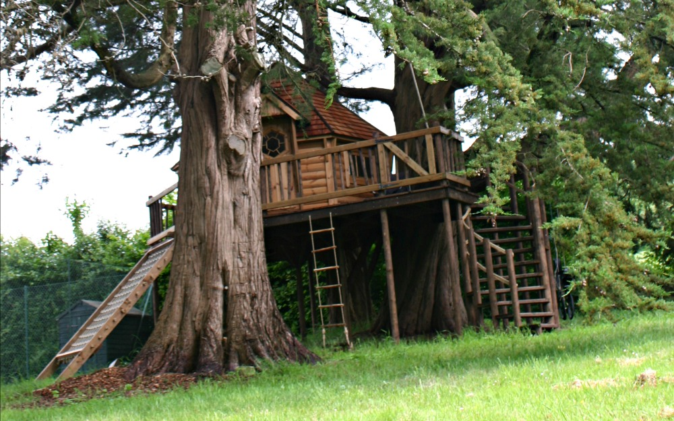
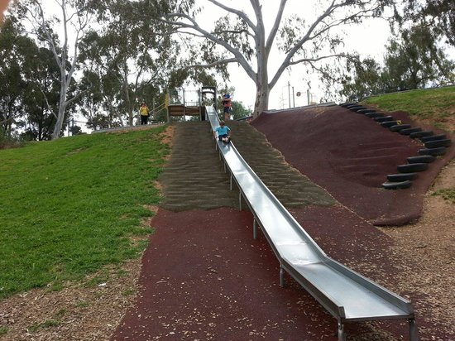
Slide
Trap Door
Ladder
Climbing Frame
Rope Bridge
GETTING IN AND OUT

Slide 21
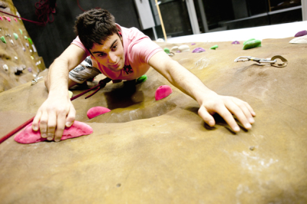
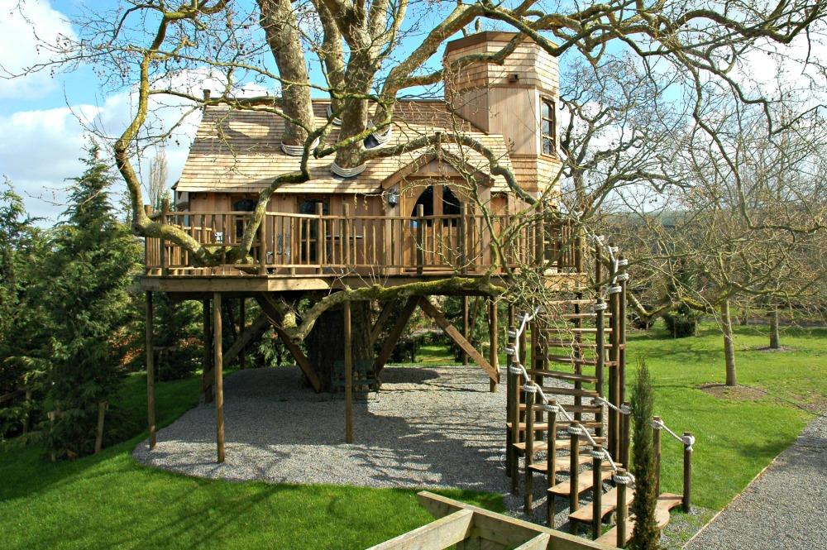
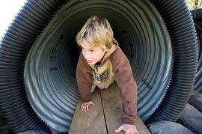
Crawl Tunnel
Climbing Wall
Stairs
GETTING IN AND OUT

Slide 22
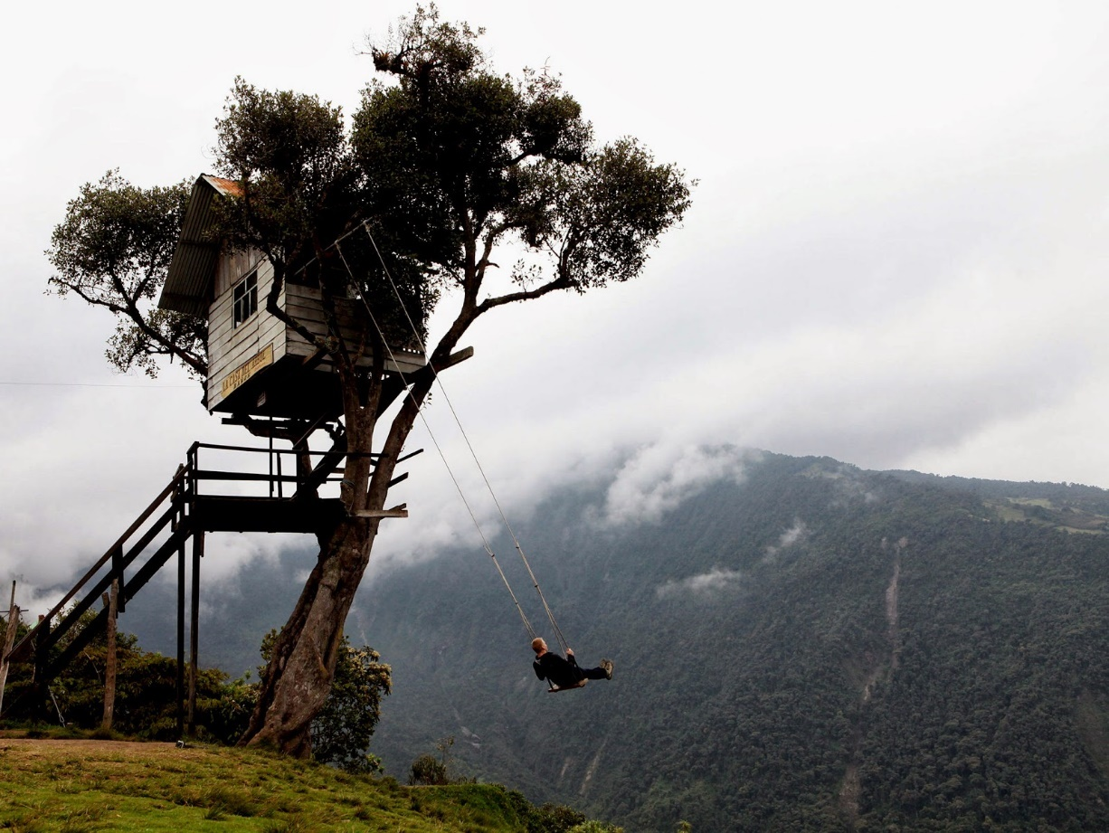
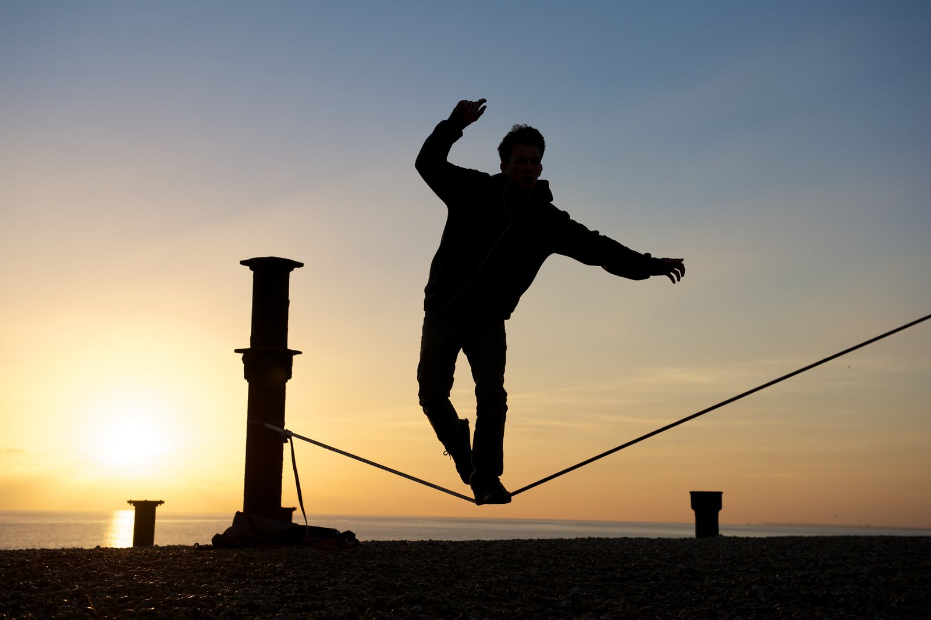
Swing
Tight Rope
Spring Board
GETTING IN AND OUT

Slide 23
Have Fun!

Slide 24
There are no such things as ‘silly questions’ so ask me anything!

