Slide 1
LO: To learn about properties of 2D shapes
Sides
Vertices
Notes:
curved -A line that is not straight
straight - A line or edge which has no curves is straight.

Slide 2
Notes:
Draw the curved edge in the air… draw the strait edge
curved -A line that is not straight
straight - A line or edge which has no curves is straight.

Slide 3
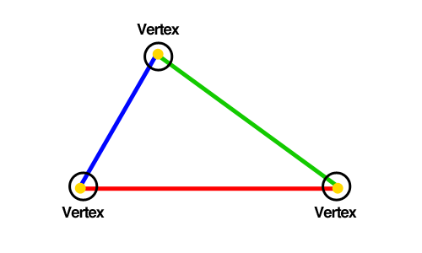
Vertices (corners)
The point where 2 sides meet.

Slide 4
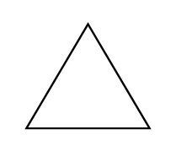
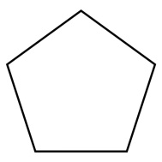
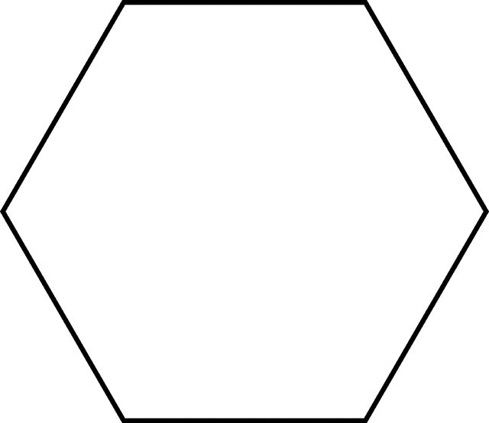
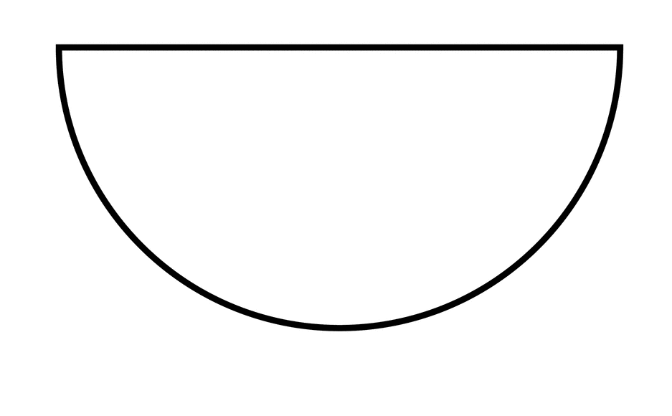
Rhombus (diamond)
Parallelogram
Trapezium
Semicircle
Ellipse
(Oval)
Pentagon
Hexagon
Octagon
Notes:
1) Polygon – only strait sides
2) Quadrilaterals – 4 sides and 4 vertices
(tell them 1 and 2, ask them to find one, and a counter example)
New shapes – semicircle pent hex octa trapez paralella rhom ellipse
Square & Rhombus/Diamond- (square on its side) equil length sides
Rectangle & parallelogram – cerial packet to demonstrate how it changes
Right angles – squ and rect

Slide 5
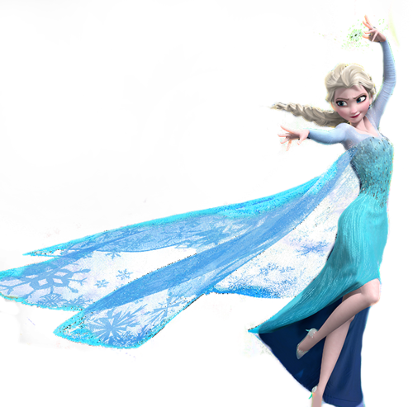
What shape can you see?

Slide 6
Notes:
hexagon

Slide 7
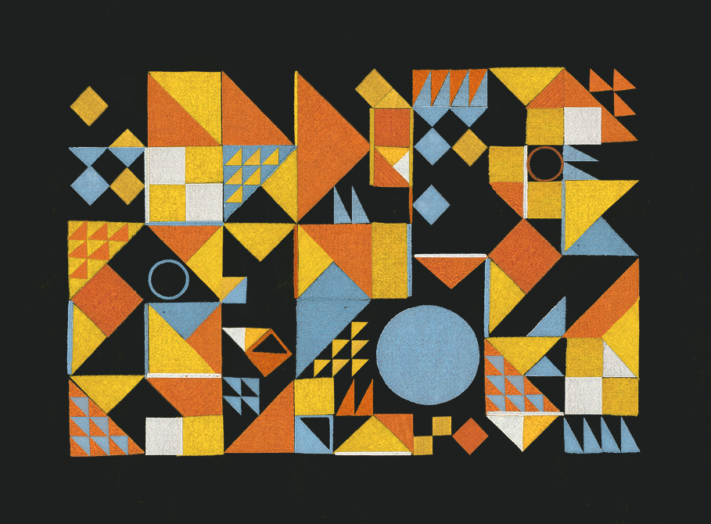
Notes:
Then give them sheets…

Slide 8
Notes:
Main activity

Slide 9
I am flat.
I have 4 straight sides of equal length.
I have 4 right angles
What am I?
Notes:
They can write their own, challenge partner. Time limit.
Make sure they know to feed back after – random name generator.

Slide 10
Notes:
Breaktime and author

Slide 11
LO: To learn about properties of 3D shapes
Vertices
Edges
Faces
Notes:
Teacher input
Vertices – like a corner but to make a sharp point.
Faces – use a 3D shape, stick childrens faces on them
Edge – next slide strait or curved
Shapes in middle of table – (name generator) can you find a .... Show me- hold in air

Slide 12
face
Notes:
Flat and curved – talk about cylinder
What shape are the faces – cube has square

Slide 13
edge
Notes:
Strait or curved
Cylinder curved
Sphere = none
Cube = straight

Slide 14
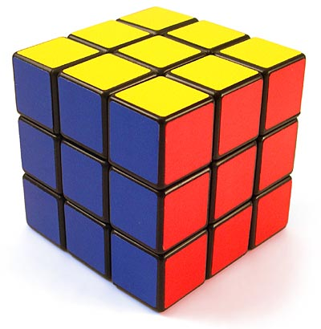
face
← vertex→
edge
Notes:
Is this right? Talk partners (10 seconds timer)
Explain why not?

Slide 15
vertex
← edge →
face
Notes:
Were they right?

Slide 16
Notes:
Polyhedron – flat faces and straight edges

Slide 17
Notes:
What do you think this shape is called?
Give picture clue
Northern southern clue
Reveal
Talk about properties.

Slide 18
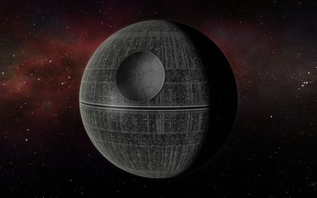
What shape am I?
How do you know?
Notes:
sphere

Slide 20
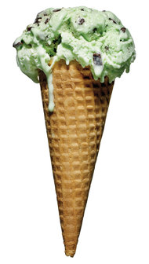
Notes:
Prisms – oposite faces are the same

Slide 21
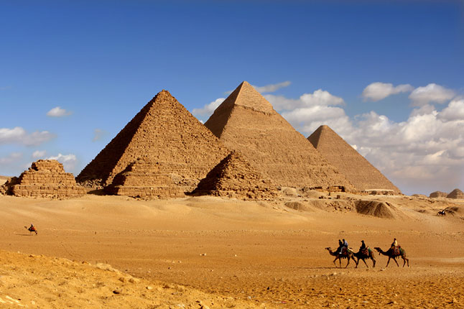
Notes:
pyramid

Slide 23
I have one curved face.
I have no edges or vertices.
What am I?
Notes:
Test eachother

Slide 24
What shapes can you see?
Notes:
Mouth – irregular octagon
Eyes – square
Head - cube
Arm/leg/body – cuboid
Minecraft cant make a perfect circle – square sunset -

Slide 25
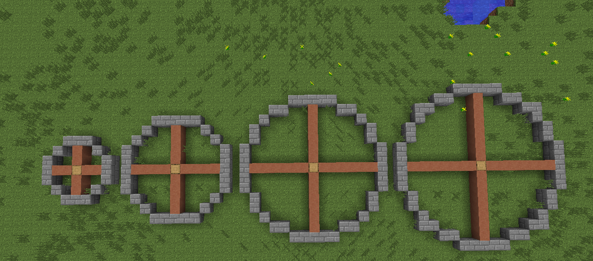
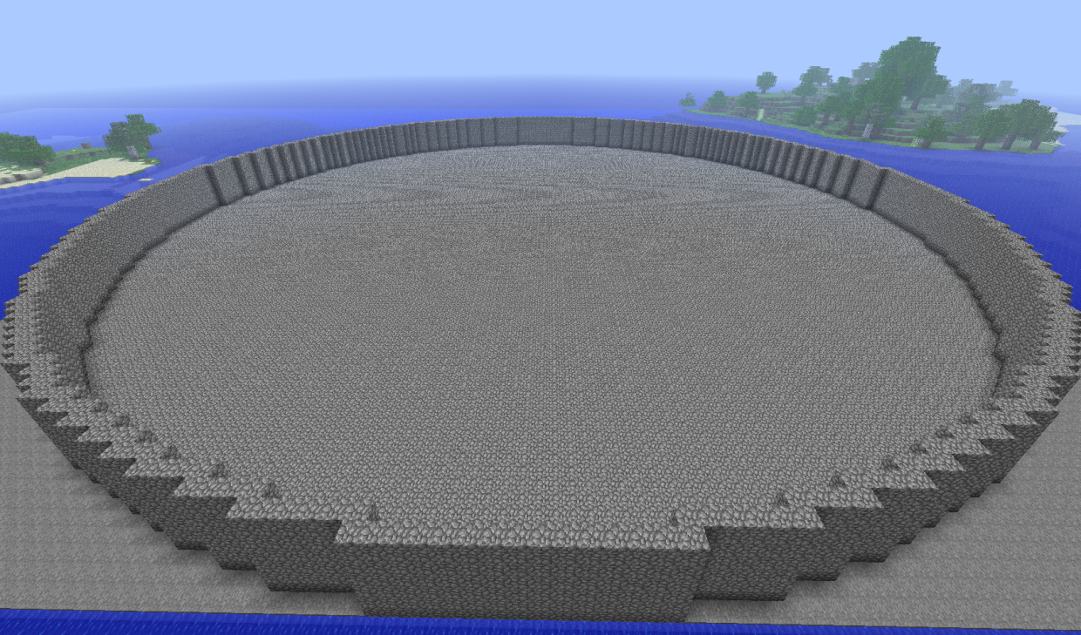
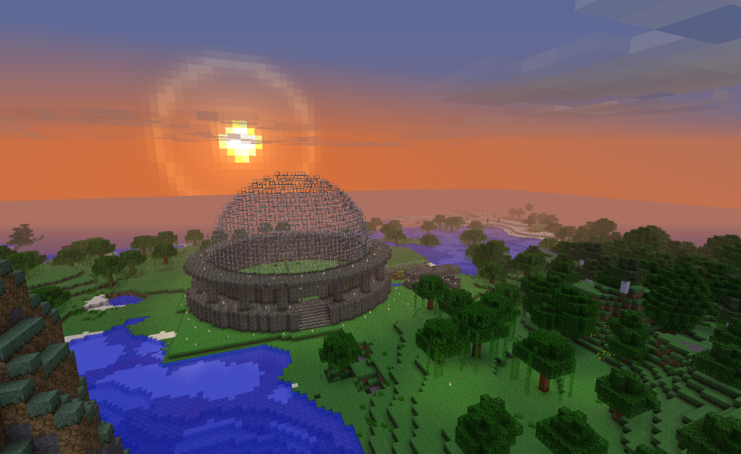
Is it possible to make a circle on Minecraft?

