Slide 1
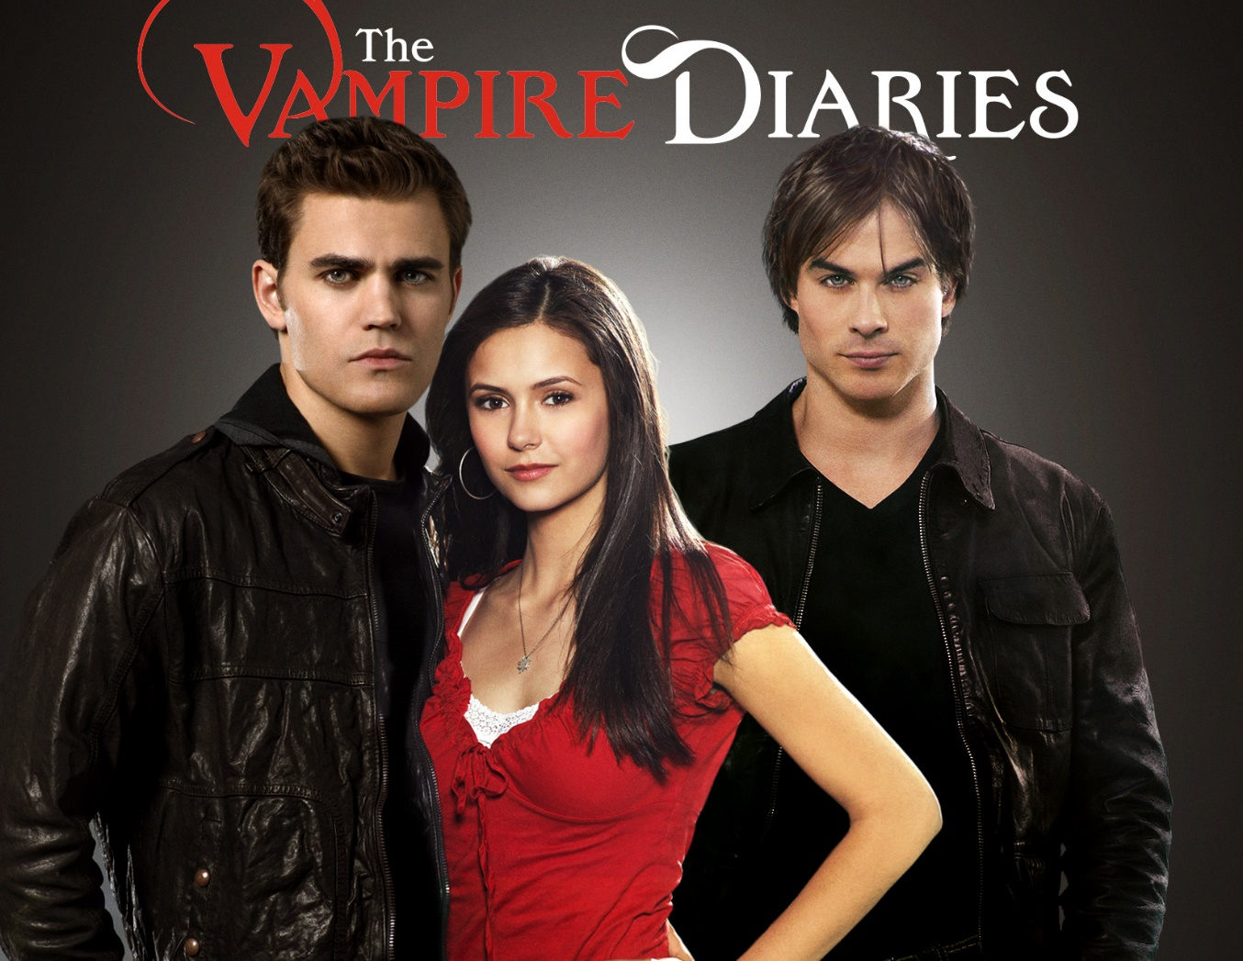
Vampire Diaries - Measures

Slide 2
What do you have to do?
Vampires are constantly having to convert between measurements. Being hundreds of years old they are used to working in imperial units and have all sorts of issues with metric units.
Can you help the vampires covert units?

Slide 3
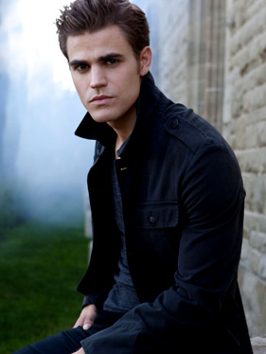
Stefan needs help with:
Stefan’s vampire ID card claims that he is $1.8m$ tall. What is that in centimetres?
Stefan’s weight is $6700g$ more than his old vampire ID card claims. What is that in kilograms?
Stefan had to drink $1.3l$of blood just to survive (he usually denies himself). How many millilitres is that?
$$180cm$$
$$6.7kg$$
$$1300ml$$

Slide 4
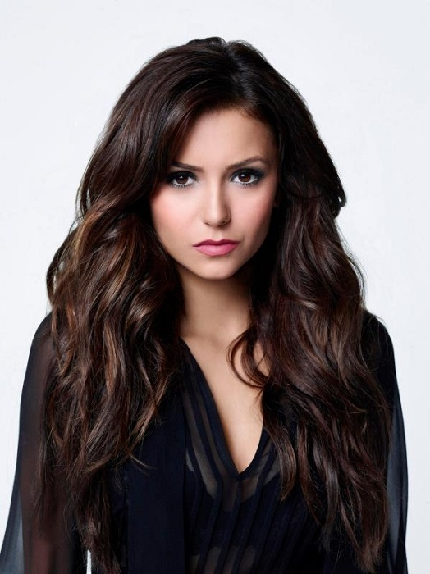
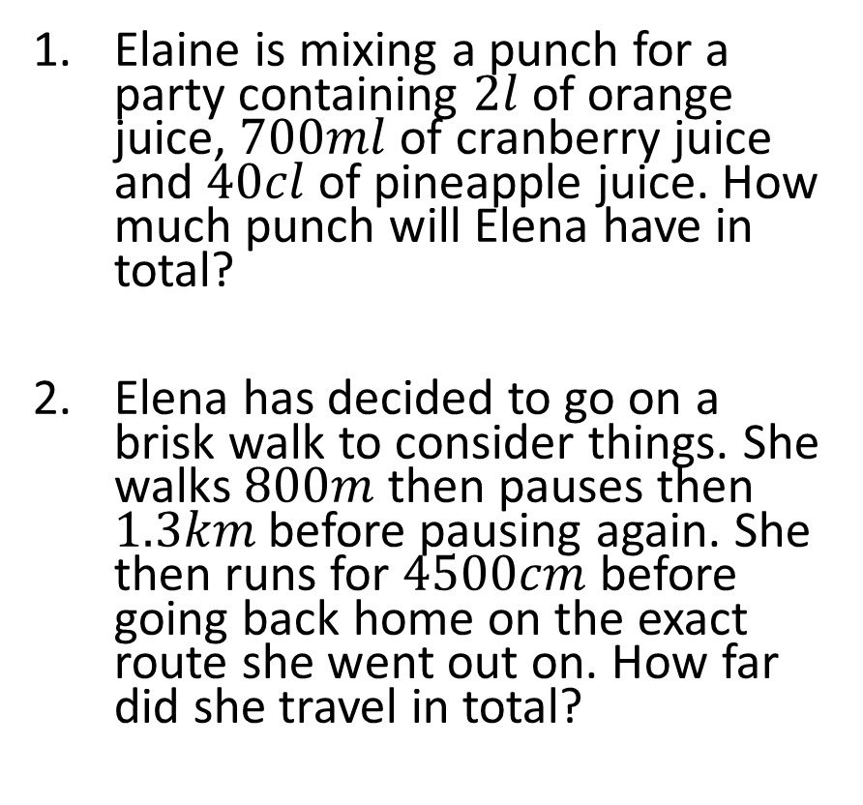
Elena needs help with:
Elaine is mixing a punch for a party containing $2l$of orange juice, $700ml$of cranberry juice and $40cl$of pineapple juice. How much punch will Elena have in total?
Elena has decided to go on a brisk walk to consider things. She walks $800m$ then pauses then $1.3km$ before pausing again. She then runs for $4500cm$ before going back home on the exact route she went out on. How far did she travel in total?
$$3.1l$$
$$4.29km$$

Slide 5
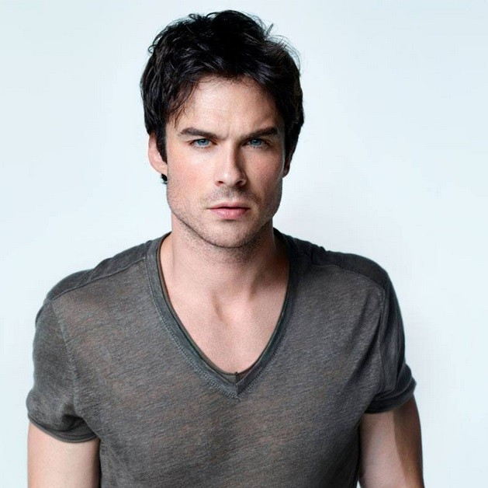
Damon needs help with:
Damon requires 5 pints of blood per week to survive. How much is that in litres?
Damon has heard that there’s some “fresh meat” 12 miles away. How far is that in kilometres?
Damon feasted on blood this week and gained 6 pounds. How much is that in grams?
$$2.845l$$
$$19.2km$$
$$2724g$$

Slide 6
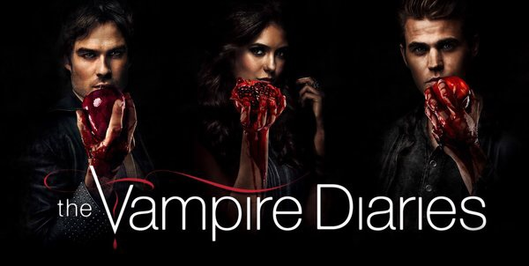
Thank you for your measured responses…

