Slide 1
X-Men Angles

Slide 2
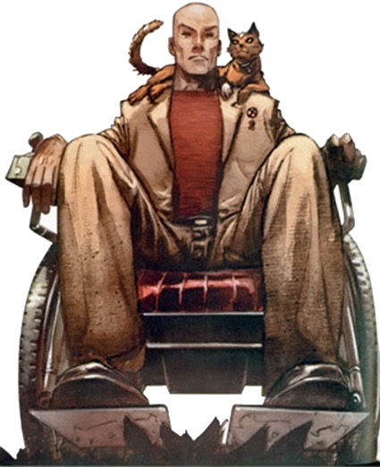
Charles Xavier has asked Wolverine to run an "Angles" class at the "School for Gifted Children". The trouble is that Wolverine's angle knowledge is a bit rusty.
Can you help Wolverine with the following questions he's set and explain the reasons behind the answers?

Slide 3
Explain the angle facts you've used to get your answers!
Question 1:
Question 2:
b
116º
a
192º

Slide 4
Explain the angle facts you've used to get your answers!
Question 3:
Question 4:
c
88º
d
51º
75º
93º
75º

Slide 5
Explain the angle facts you've used to get your answers!
Question 5:
Question 6:
62º
f
37º
e
61º

Slide 6
Explain the angle facts you've used to get your answers!
Question 7:
Question 8:
h
g
117º
53º

Slide 7
Explain the angle facts you've used to get your answers!
Question 9:
Question 10:
j
63º
k
l
134º
74º

Slide 8
If you're in Wolverine's Angles class, I'd do your homework!

