Slide 1
X-Men Venn Diagrams

Slide 2
Wolverine may be a member of the X-Men but they don't always share enemies. Charles Xavier and Wolverine are trying to prioritise which villains to concentrate their powers on (i.e. shared enemies).
Can you help put X-Men's and Wolverine's enemies into a Venn diagram to make it easier for them to decide which villains to go after first?
They have chosen 13 villains each.

Slide 3
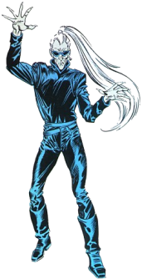
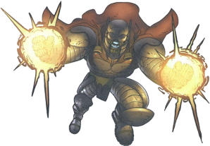
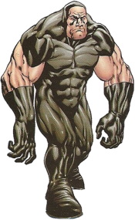
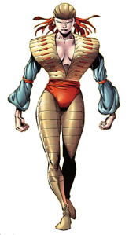
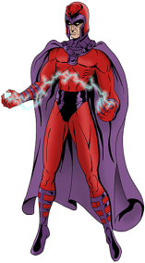
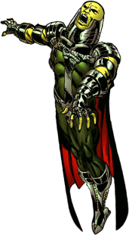
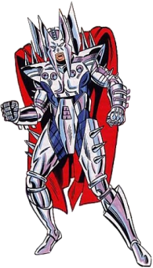
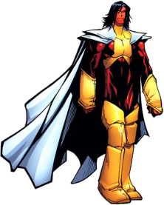
X-Men's Enemies
Wolverine's Enemies
Apocalypse
Romulus
Arcade
Sabretooth
Lord Deathstrike
Bloodscream
Bastion
Titannus
Astra
Lord Deathstrike
Bushwacker
Meltdown
Arcade
Lady Deathstrike
Phalanx
Warhawk
Magneto
Cylla
Sabretooth
Deluge
Apocalypse
Blob
Exodus
Stryfe
Magneto
Zaran

Slide 4
The Answer:
ε = {All known villains}
ε
X-Men
Wolverine
Titannus
Astra
Phalanx
Apocalypse
Bloodscream
Warhawk
Romulus
Sabretooth
Lady Deathstrike
Arcade
Deluge
Cylla
Bastion
Lord Deathstrike
Zaran
Blob
Bushwacker
Exodus
Magneto
Meltdown
Stryfe

Slide 5
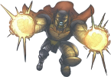
Find the following sets:
n(X ∪ W)
X ∩ W
X' ∪ W
21
Apocalypse, Arcade, Lord Deathstrike, Magneto, Sabretooth
Apocalypse, Arcade, Lord Deathstrike, Magneto, Sabretooth, Titannus, Bloodscream, Lady Deathstrike, Romulus, Cylla, Zaran, Bushwacker, Meltdown
ε = {All known villians}
ε
X-Men
Wolverine
Astra
Titannus
Phalanx
Apocalypse
Bloodscream
Warhawk
Romulus
Sabretooth
Lady Deathstrike
Deluge
Arcade
Cylla
Bastion
Lord Deathstrike
Zaran
Blob
Bushwacker
Exodus
Magneto
Meltdown
Stryfe

Slide 6
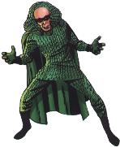
X-Men are having problems with some sets of evil mutant groups:
B = {Brotherhood of Evil Mutants}
F = {Factor Three}
ε = {All Problematic Mutant Enemies of X-Men}
ε
B
F
Astra
Quicksilver
Blob
Destiny
Ogre
Pyro
Scarlet Witch
Mastermind
Slither
Unus
Toad
Vanisher
Mystique
Magneto

Slide 7
Can you name the villains who are in each region below?
Destiny, Mystique, Pyro
1. B'
2. B ∩ F
3. B' ∪ F'
4. (B ∪ F)'
5. B ∩ F'
6. B ∪ F
Ogre, Destiny, Mystique, Pyro
Astra, Quicksilver, Scarlet Witch, Slither, Toad, Magneto
Blob, Mastermind, Unus, Vanisher
Blob, Mastermind, Unus, Vanisher
Astra, Quicksilver, Scarlet Witch, Slither, Toad, Magneto, Blob, Mastermind, Unus, Vanisher, Ogre
ε
B
F
Astra
Quicksilver
Blob
Destiny
Ogre
Pyro
Scarlet Witch
Mastermind
Slither
Unus
Toad
Vanisher
Mystique
Magneto

