Slide 1
X-Men Venn Diagrams 2

Slide 2
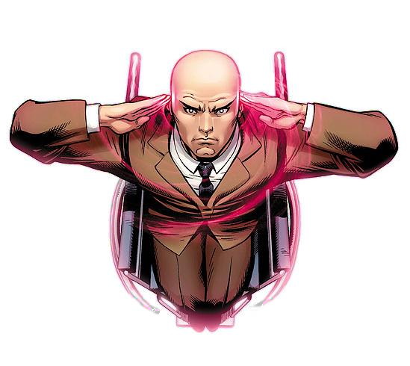
Wolverine may be a member of the X-Men but they don't always share enemies. Charles Xavier and Wolverine are trying to prioritise which villains to concentrate their powers on (i.e. shared enemies).
Can you help put X-Men's and Wolverine's enemies into a Venn diagram to make it easier for them to decide which villains to go after first?

Slide 3
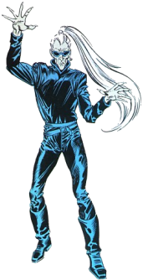
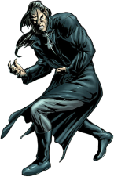
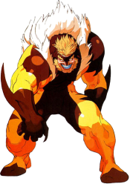
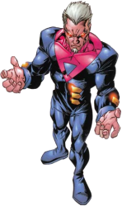
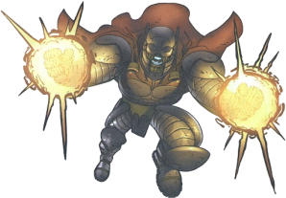
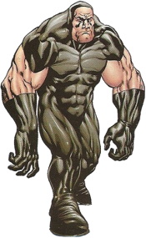
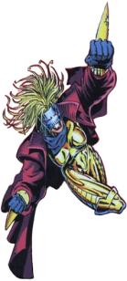
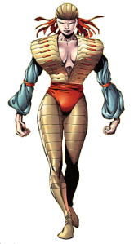
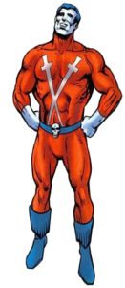
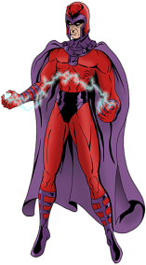
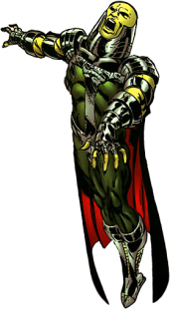
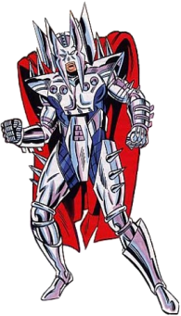
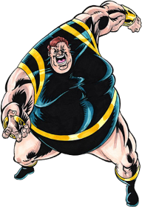
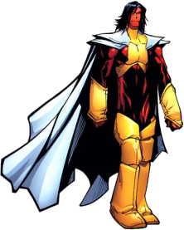
X-Men's Enemies
Wolverine's Enemies
Apocalypse
Romulus
Arcade
Sabretooth
Bloodscream
Arcade
Bastion
Titannus
Astra
Lord Deathstrike
Meltdown
Cylla
Lady Deathstrike
Phalanx
Warhawk
Magneto
Sabretooth
Deluge
Apocalypse
Blob
Exodus
Stryfe
Magneto
Zaran

Slide 4
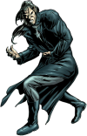
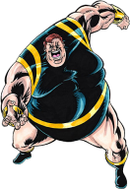
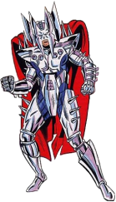
The Answer:
ε = {All known villains}
ε
X-Men
Wolverine
Astra
Titannus
Warhawk
Phalanx
Romulus
Apocalypse
Bloodscream
Bastion
Deluge
Sabretooth
Cylla
Lord Deathstrike
Arcade
Zaran
Lady Deathstrike
Blob
Magneto
Exodus
Meltdown
Stryfe

Slide 5
There are three groups of "X" heroes:
X-Men
X-Force
X-Factor
Some villains fight against one, two or all three groups.
Arrange the villains into a Venn diagram.

Slide 6
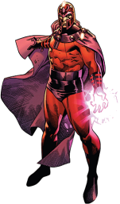
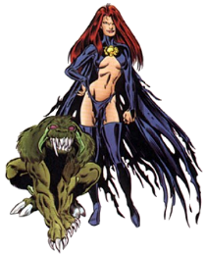
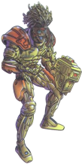
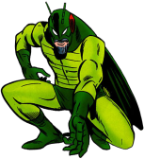
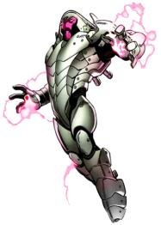
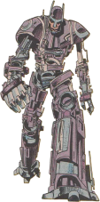
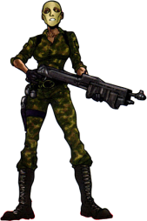
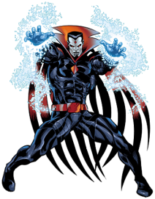
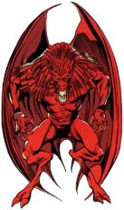
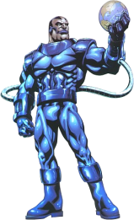
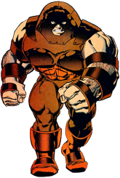
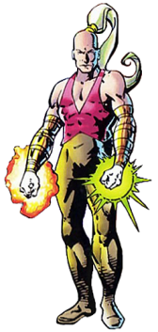
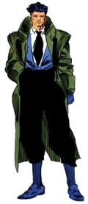
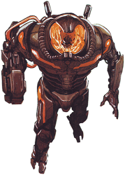
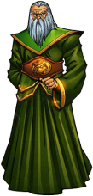
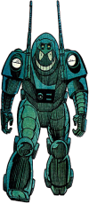
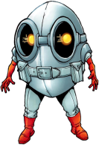
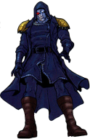
Cameron Hodge
Locust
Arcade
Magneto
Nimrod
Goblyn Queen
Master Mold
Leper Queen
N'Astrirh
Mr Sinister
Exodus
Apocalypse
Juggernaut
Shinobi Shaw
Leper Queen
Gamesmaster
Apocalypse
Genocide
Gideon
Exodus
Goblyn Queen
Damian Tryp
Cameron Hodge
The Right
Nanny
N'Astrirh
Locust
Isolationist
Apocalypse

Slide 7
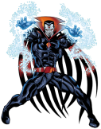
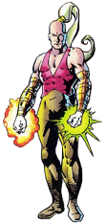
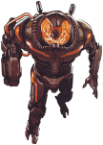
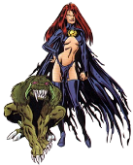
ε
Juggernaut
Arcade
Mr Sinister
Gamesmaster
Exodus
Leper Queen
Genocide
Nimrod
Magneto
Gideon
Goblyn Queen
Apocalypse
Shinobi Shaw
Master Mold
N'Astrirh
Cameron Hodge
Locust
The Right
Damian Tryp
Isolationist
Nanny

